Slide 1
Tools for Machine Learning
Lecture 1--Introduction
CISC7202 (E11-G015, Wednesday 7-10pm)
Prof. Weijia Jia (賈維嘉 IEEE Fellow)
Office hour:
Wednesday/Thu: 2—4pm/E11-4007;
7:30—9pm/N21-1012a
Email: jiawj@umac.mo
https://www.fst.um.edu.mo/en/staff/jiawj.html
Spring Semester, 2020

Slide 2
Self Introduction – Weijia Jia
• Position
• IEEE Fellow，Chair Professor, CIS Dept.
Deputy of Director, State of Key Lab of IoT for Smart City
• Research on Networking/ IoT/ Bigdata/Machine learning/NLP
https://www.fst.um.edu.mo/en/staff/jiawj.html

Slide 3
Course Administration
Reference books are
Chris Bishop. “Pattern Recognition and Machine Learning ”. Springer 2006.
Andreas C. Müller, Sarah Guido, Introduction to Machine Learning with Python, O’Reilly Media, Inc.
周志华《机器学习》清华大学出版社，2016.
Tom Mitchell. “Machine Learning ”. McGraw-Hill, 1997
• Jerome H. Friedman, Robert Tibshirani, and Trevor
Hastie. “The Elements of Statistical Learning ”. Springer 2004.
• Richard S. Sutton and Andrew G. Barto. “Reinforcement
Learning: An Introduction”, MIT, 2012.

Slide 4

Course Administration
• A hands-on machine learning course
• No paper exam
• Select two out of three course works (80%)
• in-Class hands on exercises (30%)
• out-class exercises (30%)
• In-Class presentation (20%)
• Quiz (20% -- can be any form)

Slide 5
TA Administration
• TA information:
Mr. Lin Haoxing --
Mr. Zeng Jiandian--
Mr. Yang Xingyu
Use UMmoodle
https://ummoodle.um.edu.mo/course/view.php?id=81360
• Office hour
• Wednesday 2-4pm, E11—4007;
• 4-5pm N21—1014 -- TAs will be there for QA

Slide 6
Course Objectives
Understand basic machine learning principles and algorithms
Learn the ability to solve application problems with machine learning algorithms/tools
Master the basic method of common machine learning algorithms with sklearn library and others.

Slide 7
Goals of This Course
• Knowing about the big picture of Tools and principles of machine learning (TML)
Sklearner (SciKit Learn)
TensorFlow (extensive TML tool -- optional)
Keras (Deep learning framework -- optional)
Get familiar with popular ML methodologies
• Data representations
Models
Learning algorithms
Experimental methodologies
Get some first-hand ML developing experiences
Present your own ML solutions to real-world problems

Slide 8
Introduction to Machine Learning

Slide 9
Introduction to Machine Learning
https://towardsdatascience.com/coding-deep-learning-for-beginners-types-of-machine-learning-b9e651e1ed9d

Slide 10

Why Hands-on/Tools of ML?
Academia
Theoretical novelty
Solid math
Communication
Hands/
Tools-of ML
Industry
Large-scale
Startup
Application
novelty
practice
Solid
engineering
• So play with the data/programs and get your hands on!

Slide 11
Artificial Intelligence
• Artificial intelligence (AI) is intelligence exhibited by
machines.
• The subject AI is about the methodology of
designing machines to accomplish intelligence-
based tasks.
• Intelligence is the computational part of the ability
to achieve goals in the world.
http://www-formal.stanford.edu/jmc/whatisai/whatisai.html

Slide 12
Methodologies of AI
• Rule-based
• Implemented by direct programing
• Inspired by human heuristics
• Data-based
• Expert systems
• Experts or statisticians create rules of predicting or decision
making based on data
• Machine learning
• Direct making prediction or decisions based on the data
• Data Science

Slide 13
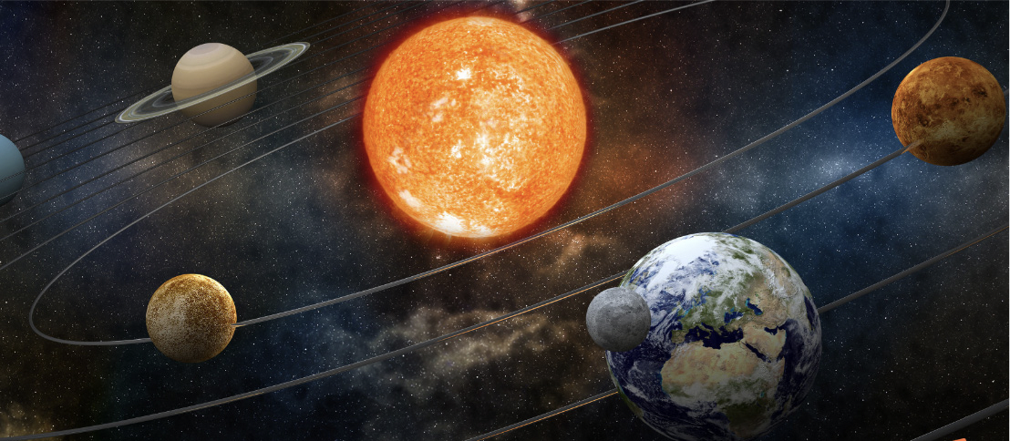
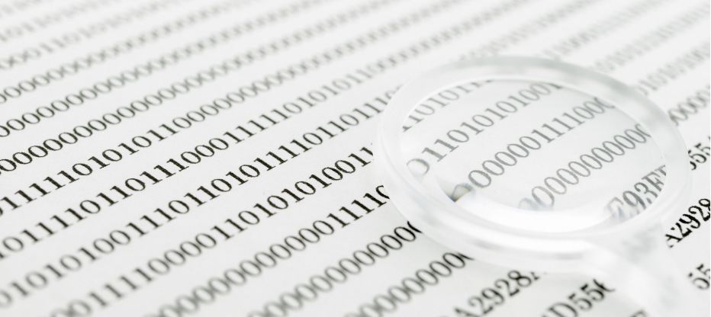
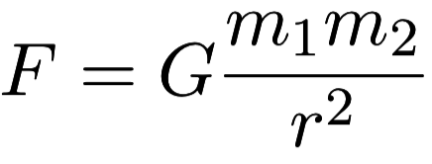
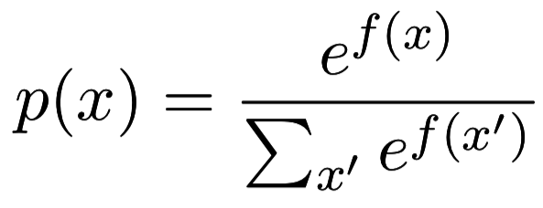
What is ML for Data Science
• Physics
• ML for Data Science
• Goal: discover the
Goal: discover the
underlying principle of the
data
•
underlying principle of the
world
• Solution: build the model of
Solution: build the model of
the data from observations
•
the world from observations

Slide 14
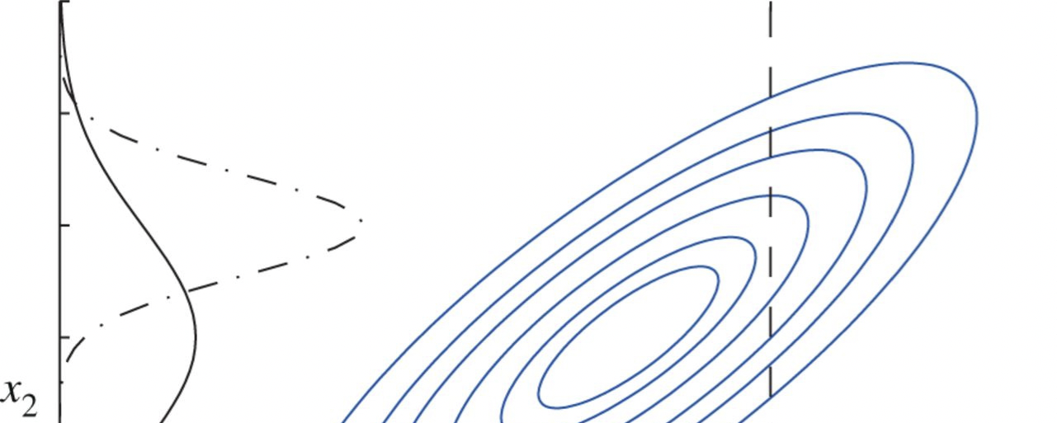
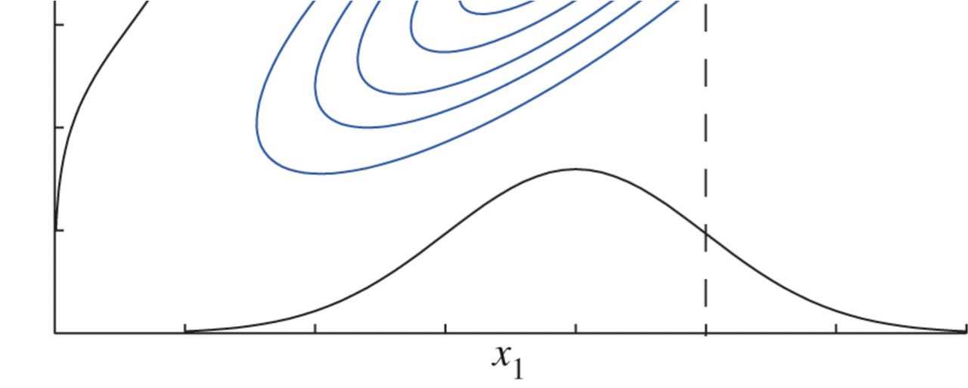
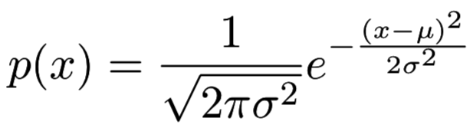
ML for Data Science
• Mathematically
• Find joint data
distribution
p(x)
• Conditional distribution
• Gaussian distribution
• Multivariate
• Univariate

Slide 15
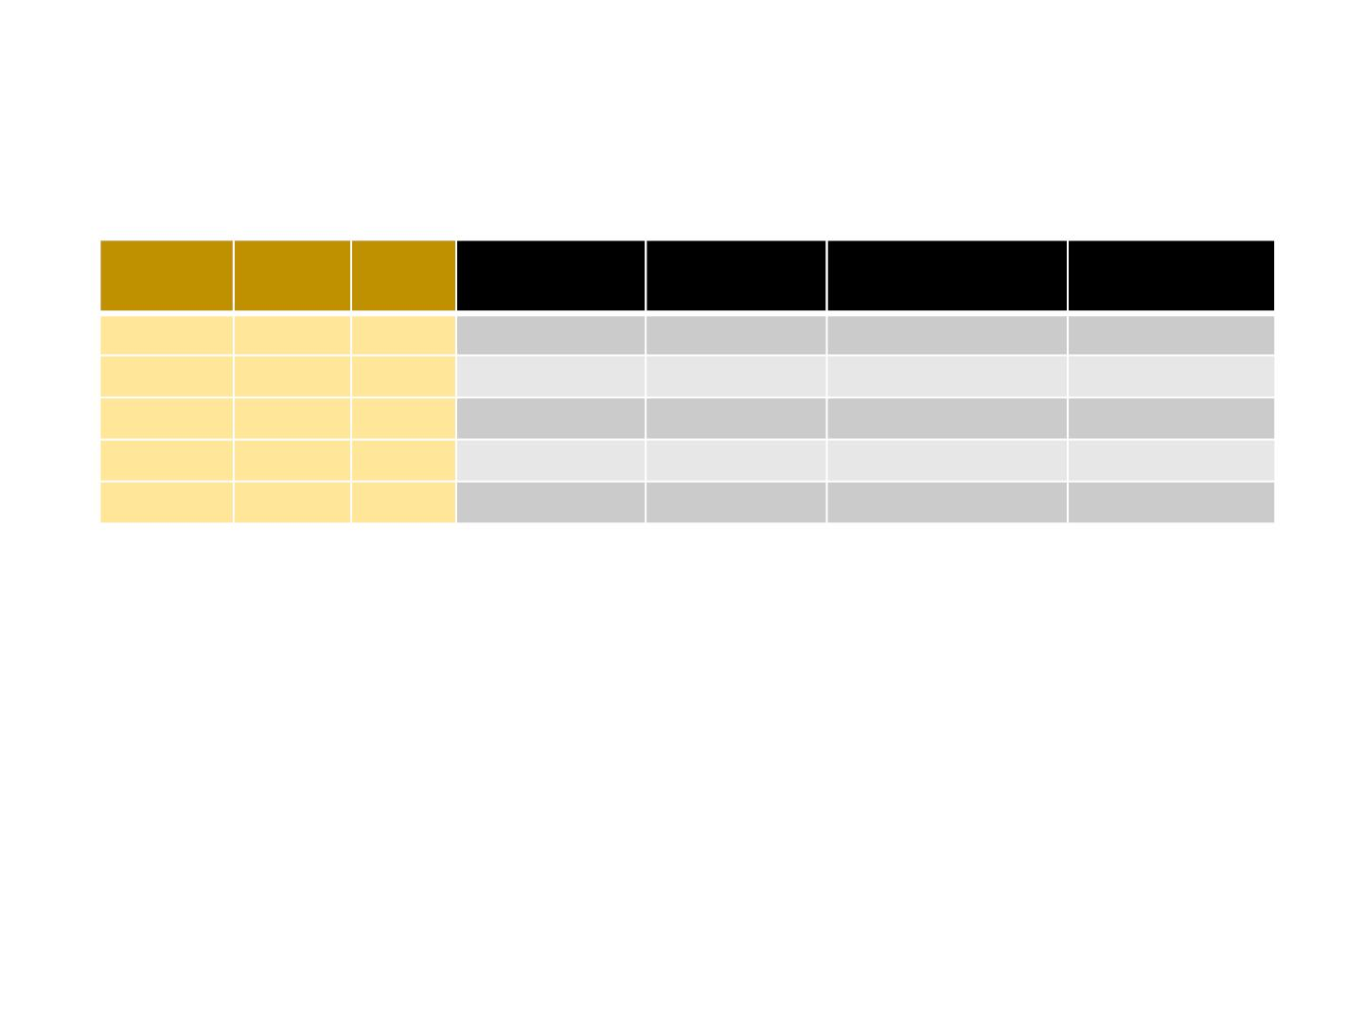
A Simple Example in User Behavior Modelling
Interest
Gender
Age
BBC Sports
PubMed
Bloomberg
Business
Spotify
Finance
Sports
Male
Male
29
21
32
25
40
Yes
Yes
No
No
Ye s
No
No
Yes
No
Yes
Yes
No
No
No
Ye s
No
Yes
No
Yes
No
Medicine Female
Music
Female
Male
Medicine
• Joint data distribution
p(Interest=Finance, Gender=Male, Age=29, Browsing=BBC Sports, Bloomberg Business)
• Conditional data distribution
p(Interest=Finance | Browsing=BBC Sports,Bloomberg Business)
p(Gender=Male | Browsing=BBC Sports,Bloomberg Business)

Slide 16
Conditional Probability （條件概率）

Slide 17
Conditional Probability （條件概率推導）
If we consider only those instances for which , then the fraction of such instances for which is written as
is called the Conditional probability of
given
Prob. X take value x_{i} & Y take value y_{j} where N=M x L
, P(Y=y_{i}) = …
Product rule of probability

Slide 22
Example：

Slide 23
Prior Probability & Posterior Probability

Slide 24
Prior Probability & Posterior Probability

Slide 26
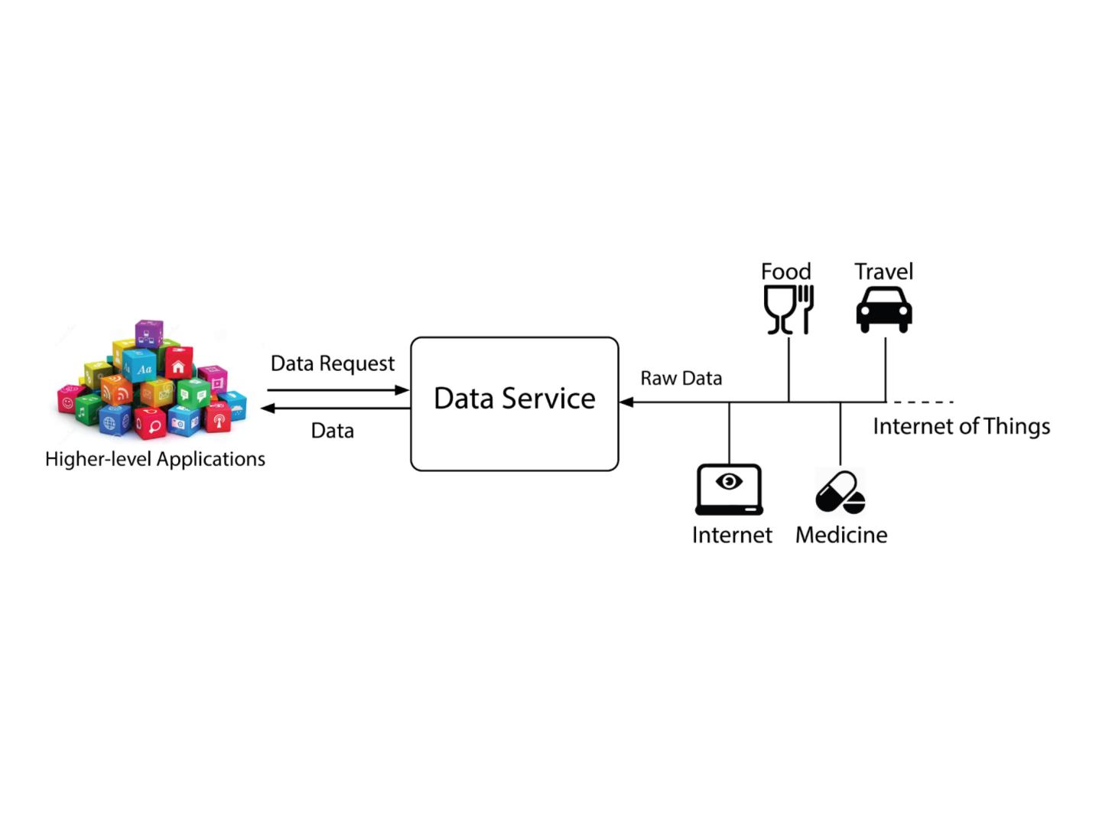
Data Technology
Data itself is not valuable, data service is!

Slide 27
Why ML？TML?
ML is programming computers to optimize a performance criterion using example data or past experiences.
There is no need to “learn” to calculate payroll learning is used when:
Human expertise does not exist (navigating on Mars),
Humans are unable to explain their expertise (speech recognition)
Solution changes in time (routing on a computer networks)
Solution needs to be adapted to particular cases (user biometrics)

Slide 28
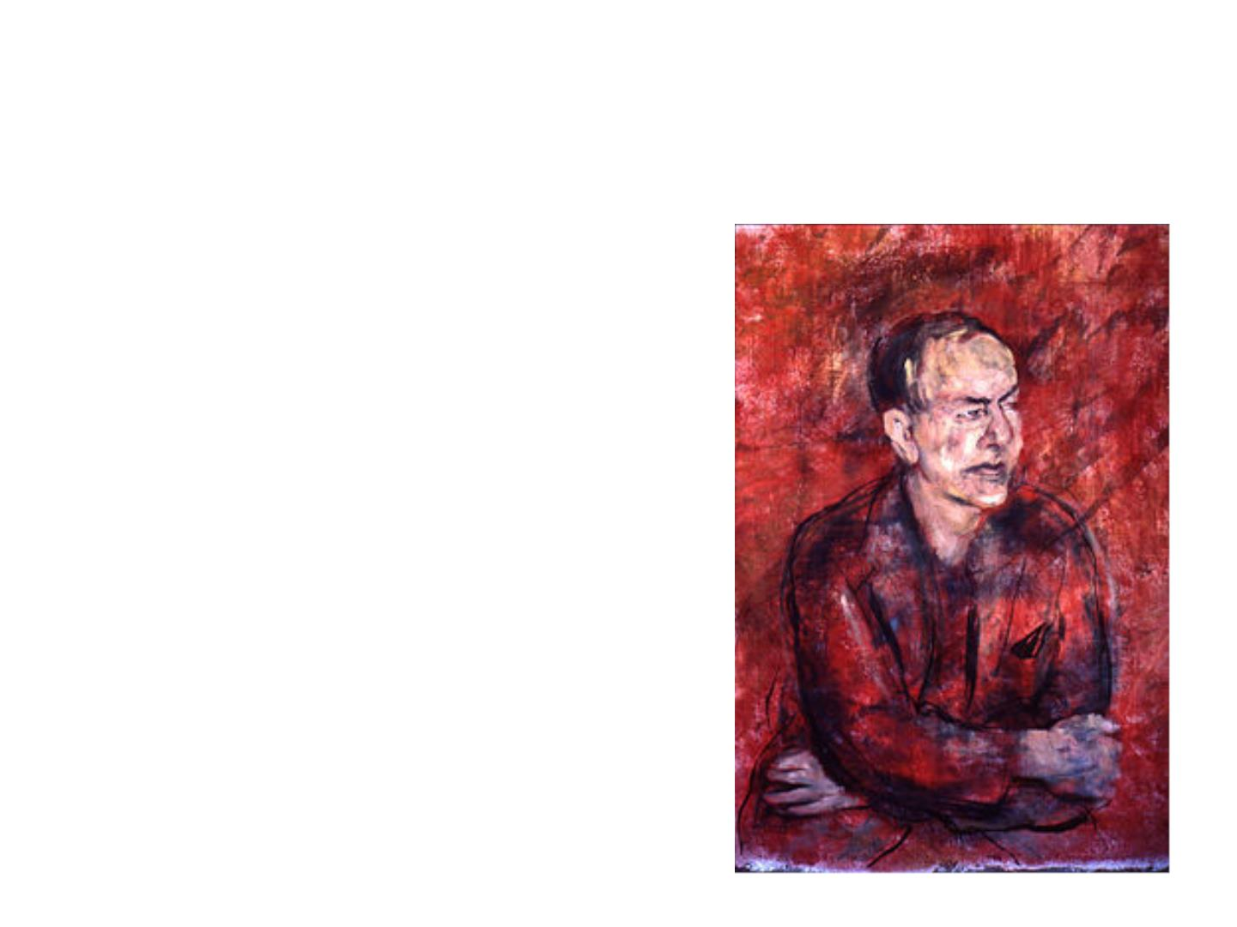
What is ML?
“Learning is any process by
which a system improves
performance from experience.”
--- Herbert Simon
Carnegie Mellon University
Turing Award (1975)
artificial intelligence, the psychology of human cognition
Nobel Prize in Economics (1978)
decision-making process within economic organizations

Slide 29
What is ML?
A more mathematical definition by Tom Mitchell
• Machine learning is the study of algorithms that
• improve their performance P
• at some task T
• based on experience E
• with non-explicit programming
• A well-defined learning task is given by <P, T, E>

Slide 30
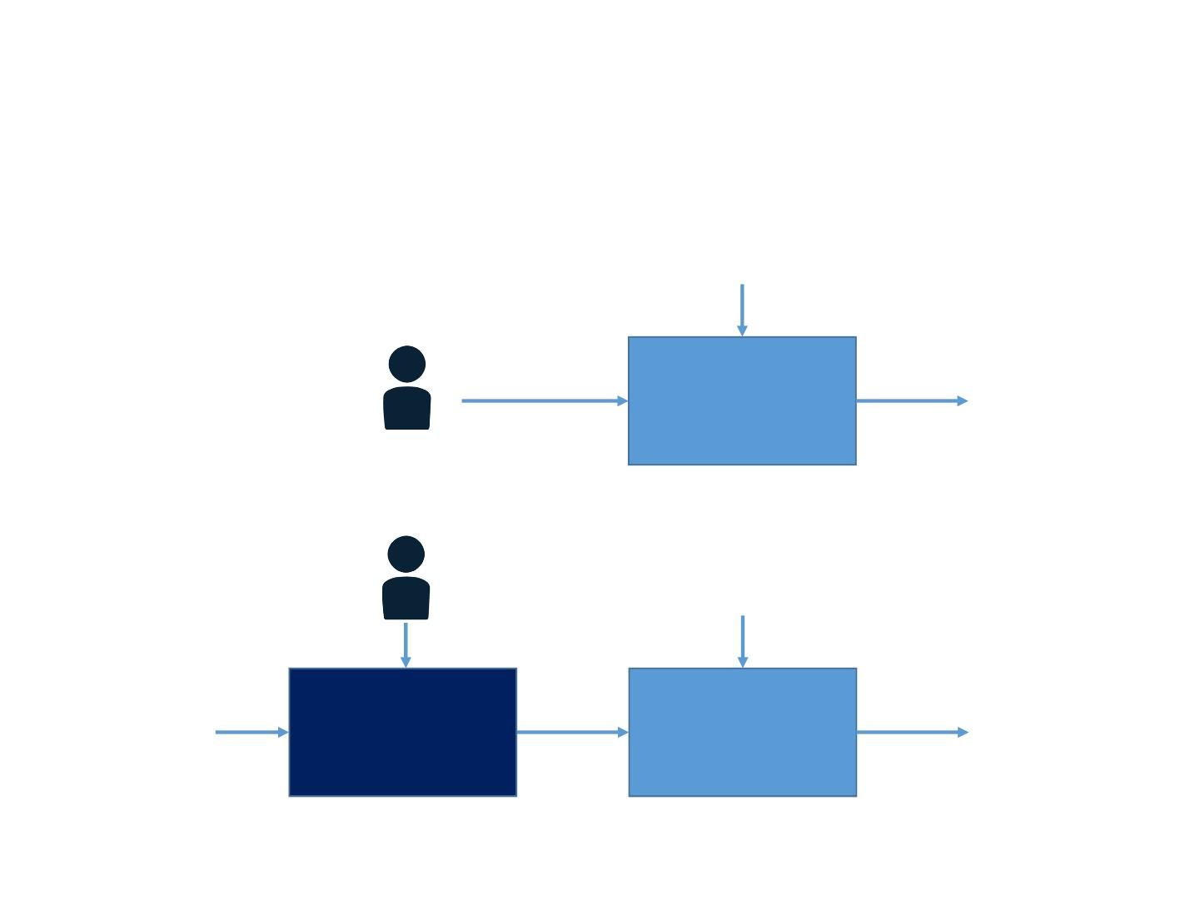
Programming vs. ML
• Traditional Programming
Input
Human
Programmer
Program
Output
• ML
Input
Learning
Data
Program
Output
Algorithm
Slide credit: Feifei Li

Slide 31
When does ML make Advantages
ML is used when
• Models are based on a huge amount of data
• Examples: Google web search, Facebook news feed
• Output must be customized
• Examples: News / item / ads recommendation
• Humans cannot explain the expertise
• Examples: Brain understanding, Speech / face recognition, game of Go …
• Human expertise does not exist
• Examples: Navigating on Mars

Slide 32
Two Kinds of ML
• Prediction
• Predict the desired output given the data (supervised
learning)
• Generate data instances (unsupervised learning)
• Decision Making
• Ta ke actions in a dynamic environment (reinforcement
learning)
• to transit to new states
• to receive immediate reward
• to maximize the accumulative reward over time

Slide 33
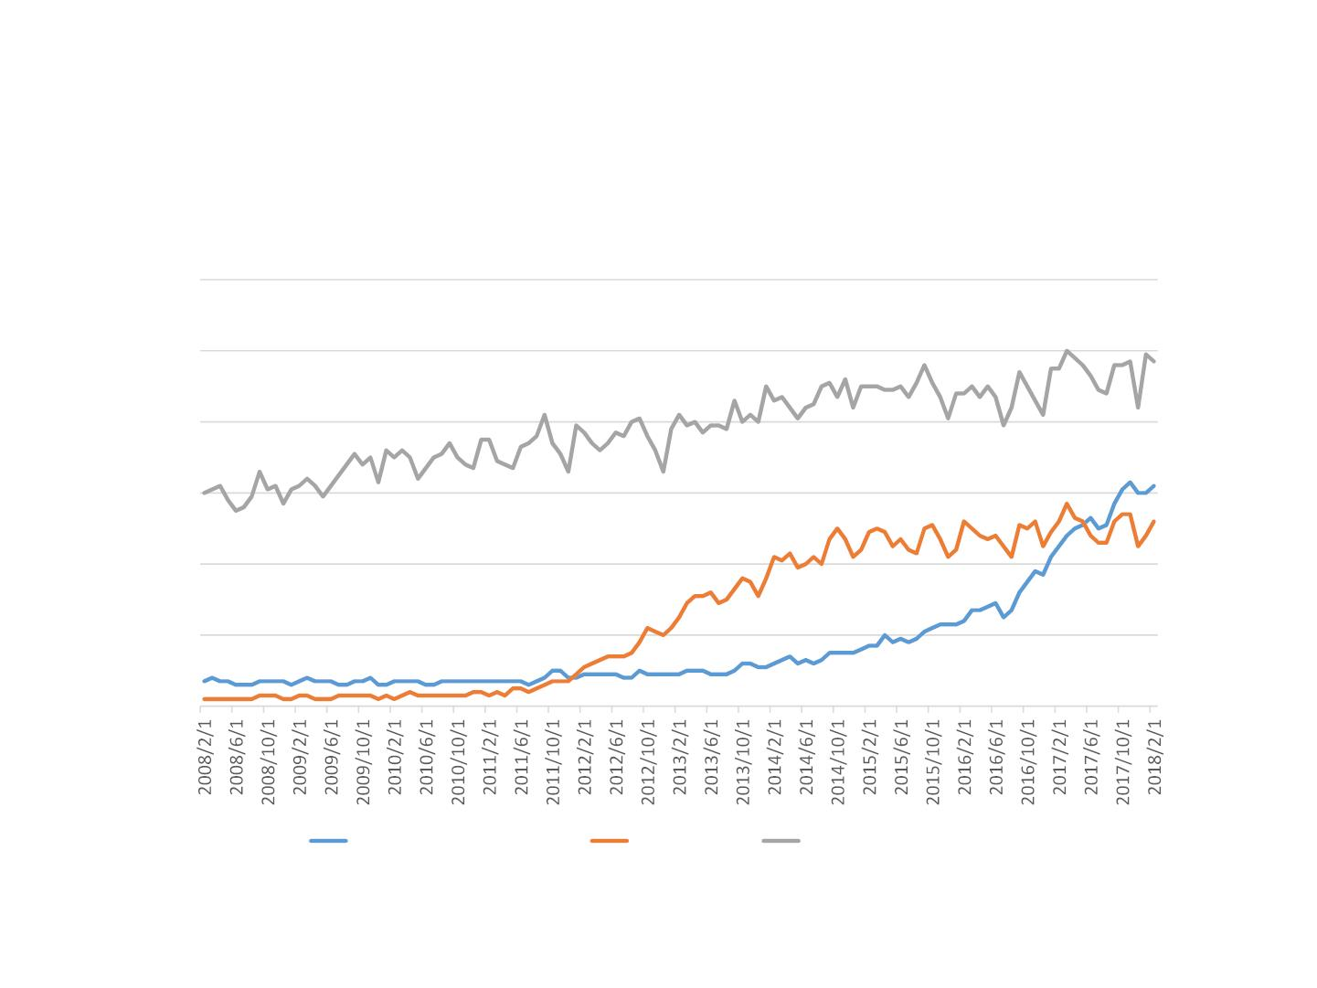
Trends
Google Search Trends
120
100
80
60
40
20
0
machine learning
big data
computer science
https://www.google.com/trends

Slide 34
Some ML Use Cases

Slide 35
Knowledge Graph (KG) – Predict Entity/Relations
Triples in KGs.
(Isaac Newton, _birth_in, Lincolnshire)
How to predict the missing part: (A,r, ?), (A, ?, B), (?,r, B)
Knowledge
Graph
Vector
Space
John was born in ?
John was born in Miami
S. Ma, J. Ding and Weijia Jia, TransT: Type-based Multiple Embedding Representations for Knowledge Graph Completion, Joint European Conference on Machine Learning and Knowledge Discovery in Databases, 2017.
Notes:
如前面所说，在知识图谱中，知识通常被结构化成三元组的形式。而知识图谱补全主要致力于补全三元组，即预测三元组中缺失的元素。按照缺失元素的类型，通常把KGC分成两个任务：实体预测和关系预测。Normal KGC仅涉及In-KG entities，而不涉及任何Out-of-KG entities。关于Normal KGC, 学术界目前最有效的方法是translation-based model。

Slide 36
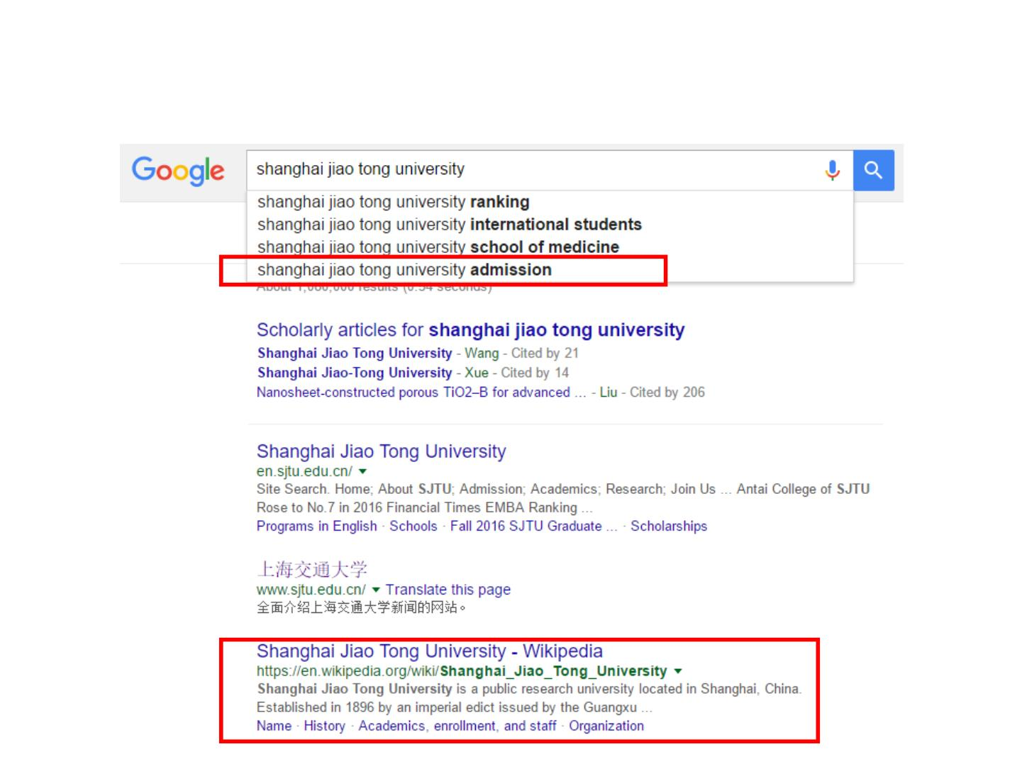
ML Use Case 1: Web Search
• Query suggestion
• Page ranking

Slide 37
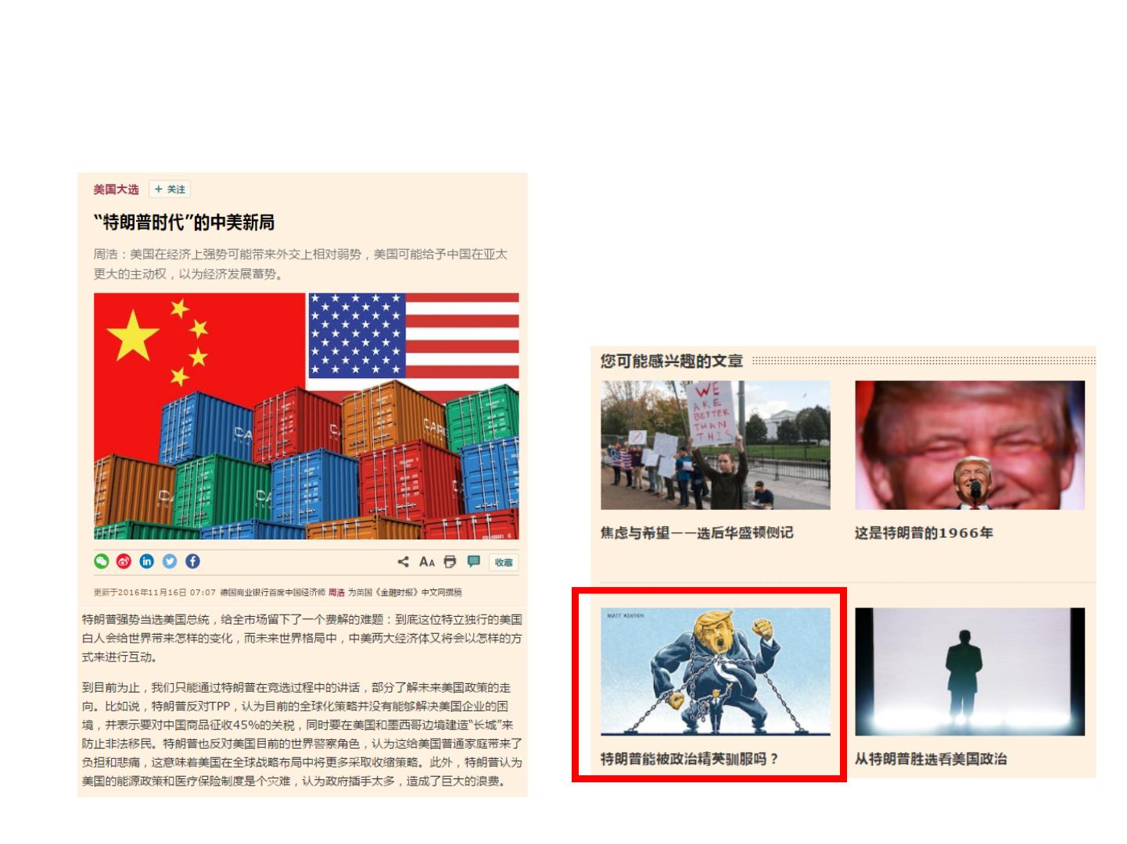
ML Use Case 2: News Recommendation
• Predict whether a user
will like a news given its
reading context
Trump impeachment

Slide 38
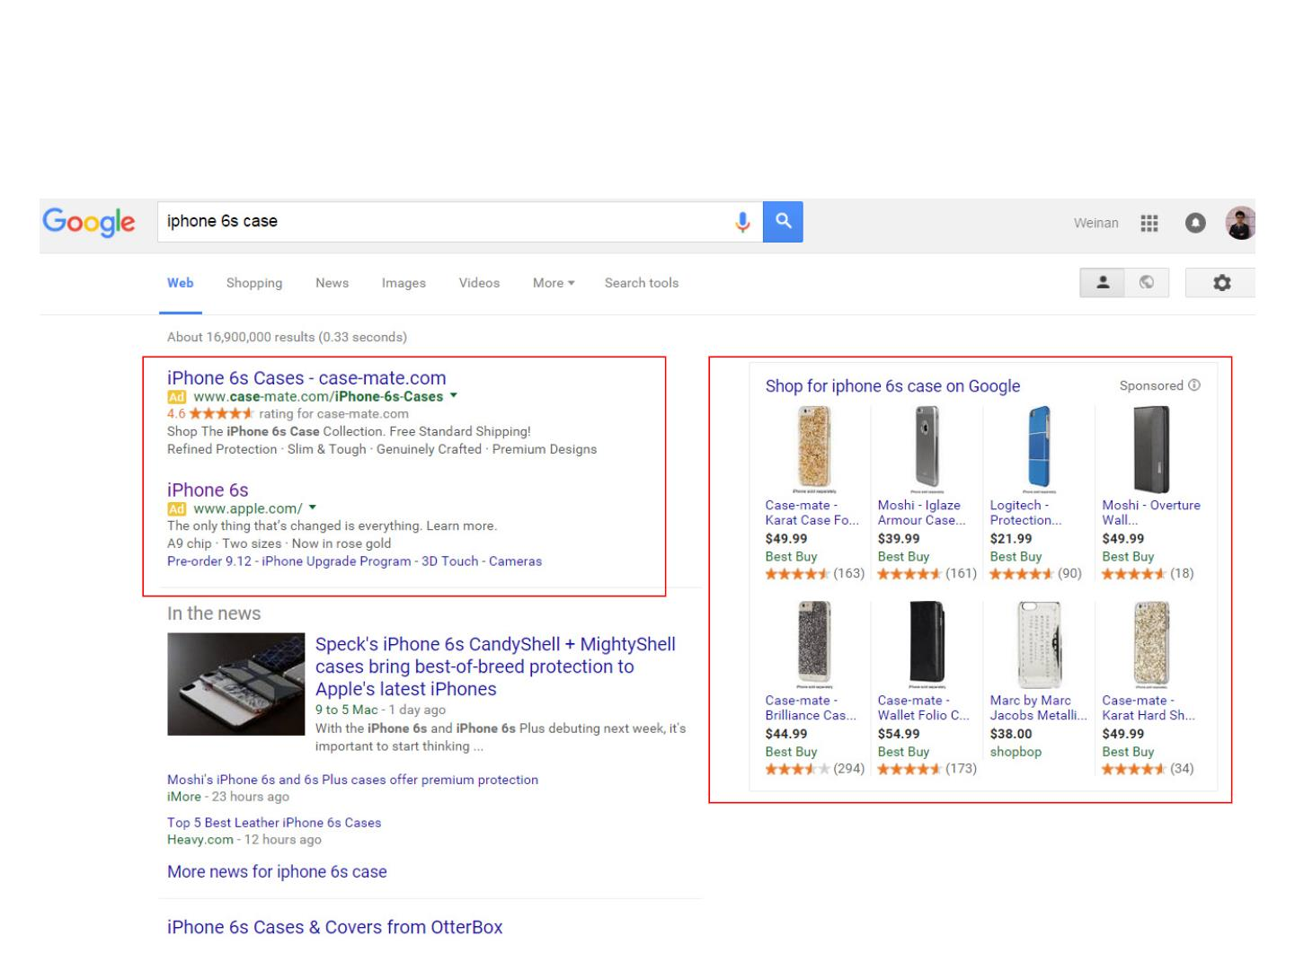
ML Use Case 3: Online Advertising
• Whether the user likes the ads
• How advertisers set bid price

Slide 39
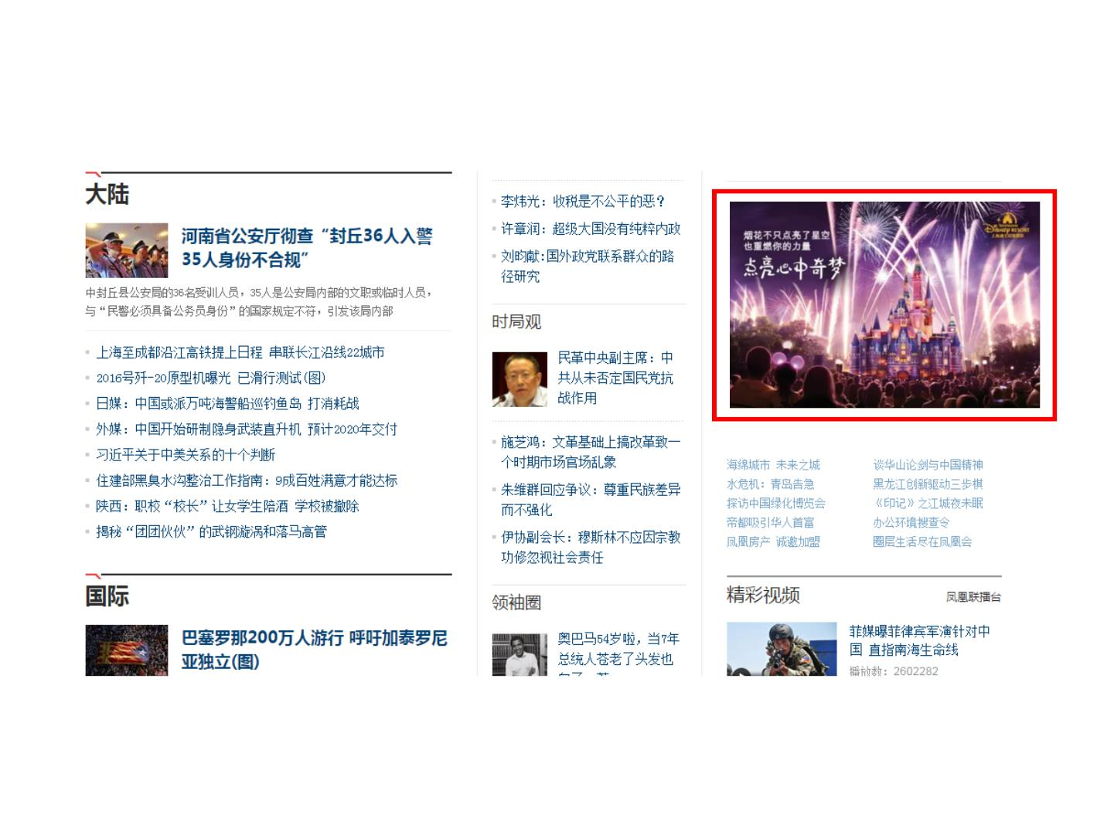
ML Use Case 3: Online Advertising
• Whether the user likes the ads
• How advertisers set bid price
https://github.com/wnzhang/rtb-papers

Slide 40
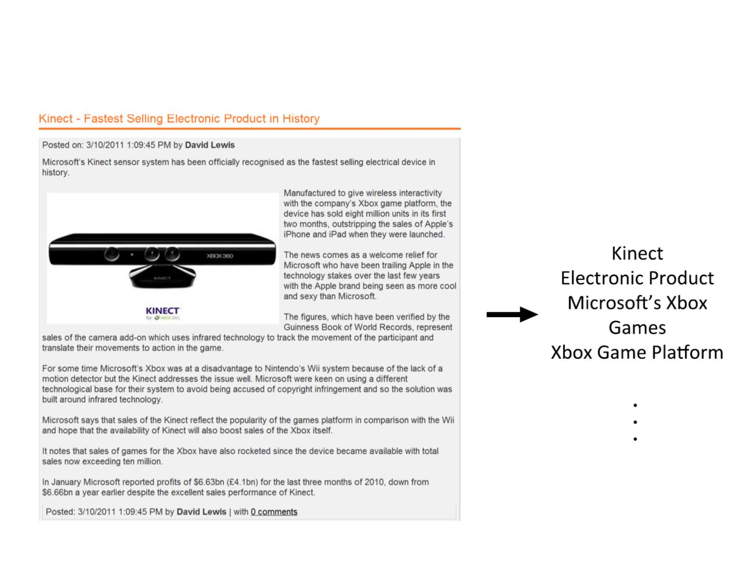
ML Use Case 4: Information Extraction
Webpage
Keywords

Slide 41
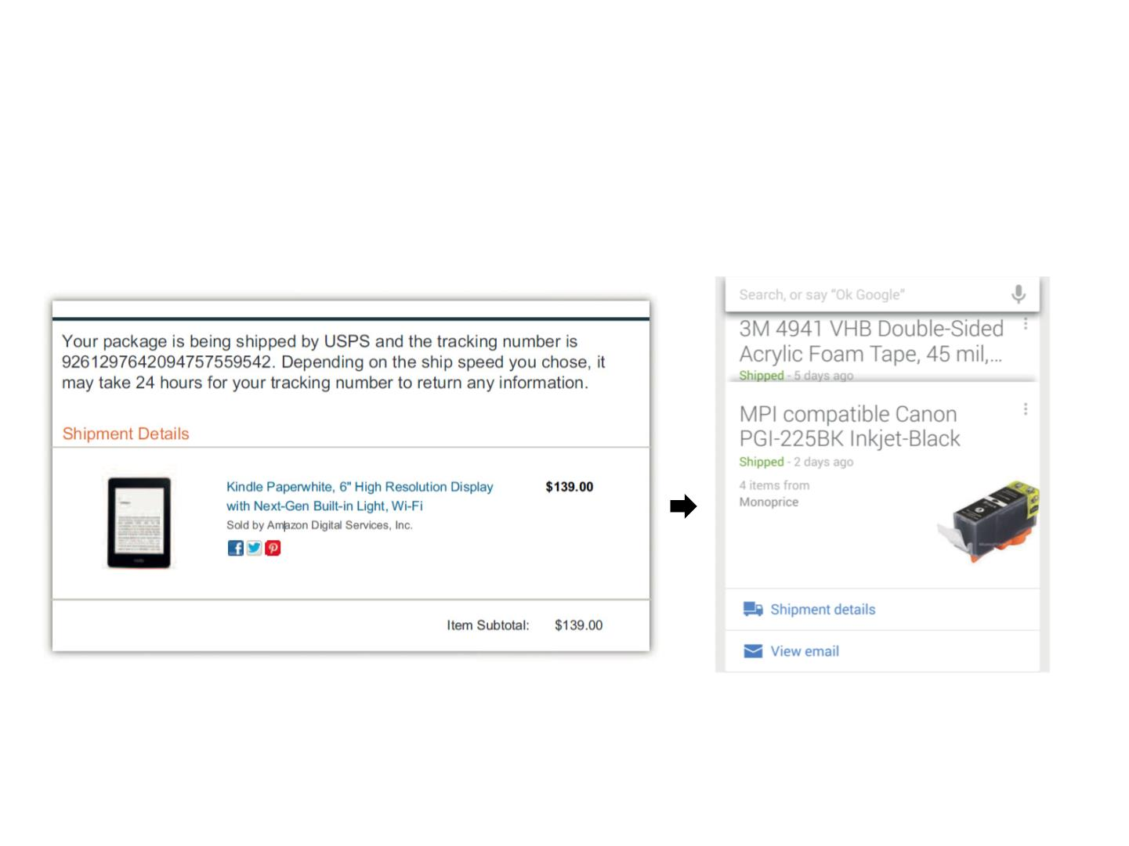
ML Use Case 4: Information Extraction
• Structural information extraction and illustration
Gmail
Google Now
Zhang, Weinan, et al. Annotating needles in the haystack without looking: Product information extraction from emails. KDD 2015.

Slide 42
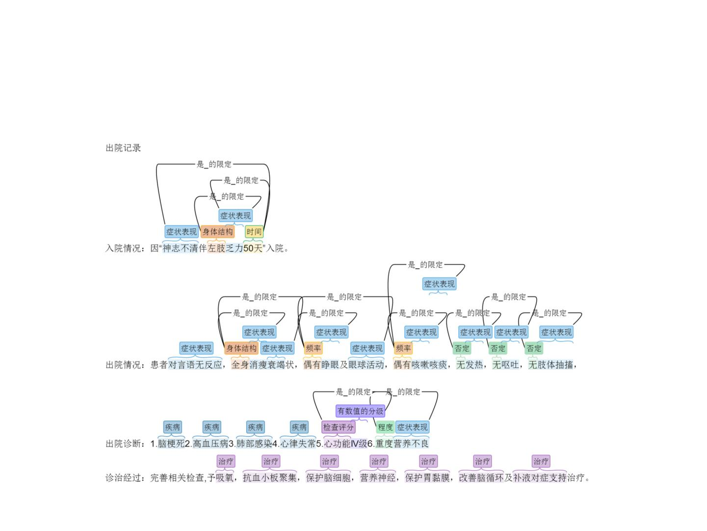
ML Use Case 4: Information Extraction
• Clinical medicine structural information extraction
Zhenghui Wang, Weinan Zhang et al. Label-aware Double Transfer Learning for Cross Specialty Medical Named Entity Recognition. NAACL 2018.

Slide 43
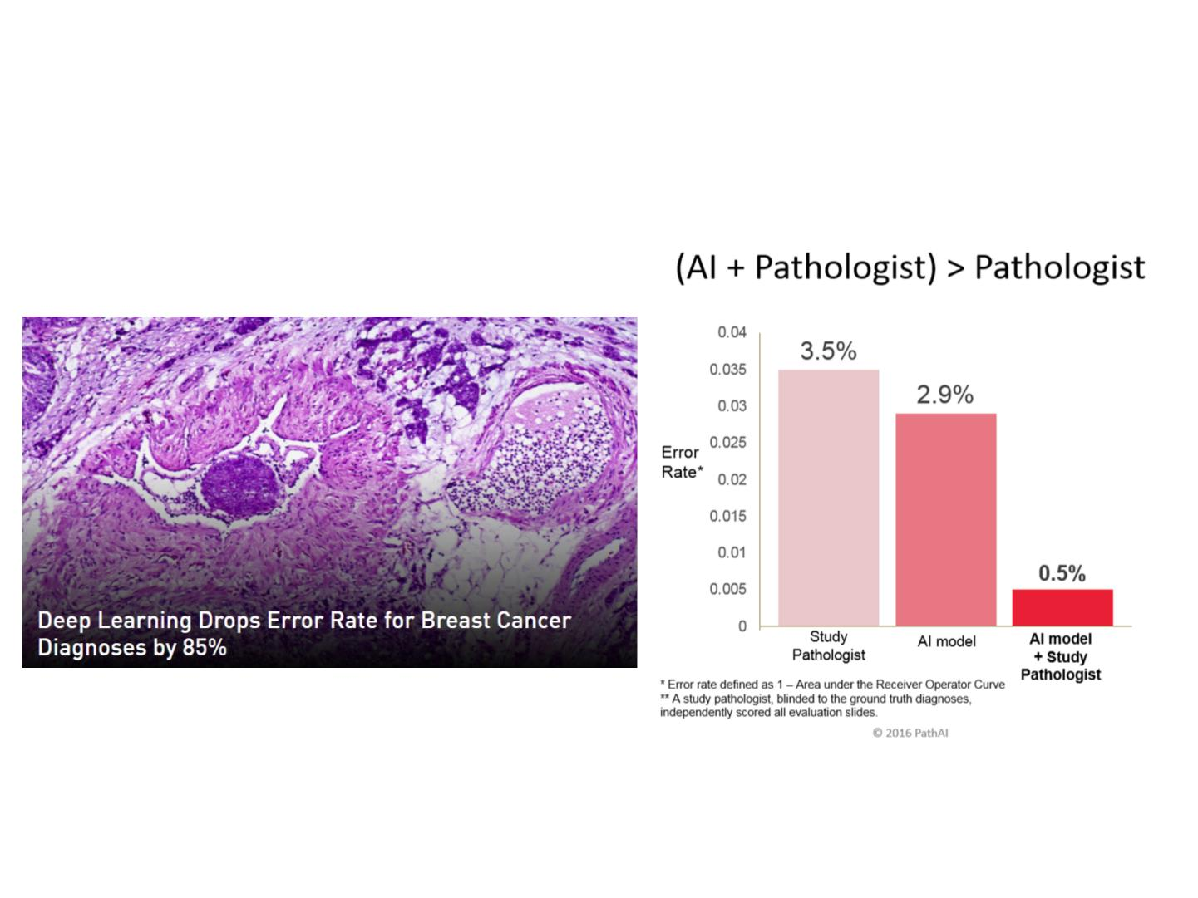
ML Use Case 5: Medical Image Analysis
• Breast Cancer Diagnoses
Wang, Dayong, et al. "Deep learning for identifying metastatic breast cancer." arXiv preprint arXiv:1606.05718 (2016).
https://blogs.nvidia.com/blog/2016/09/19/deep-learning-breast-cancer-diagnosis/

Slide 44
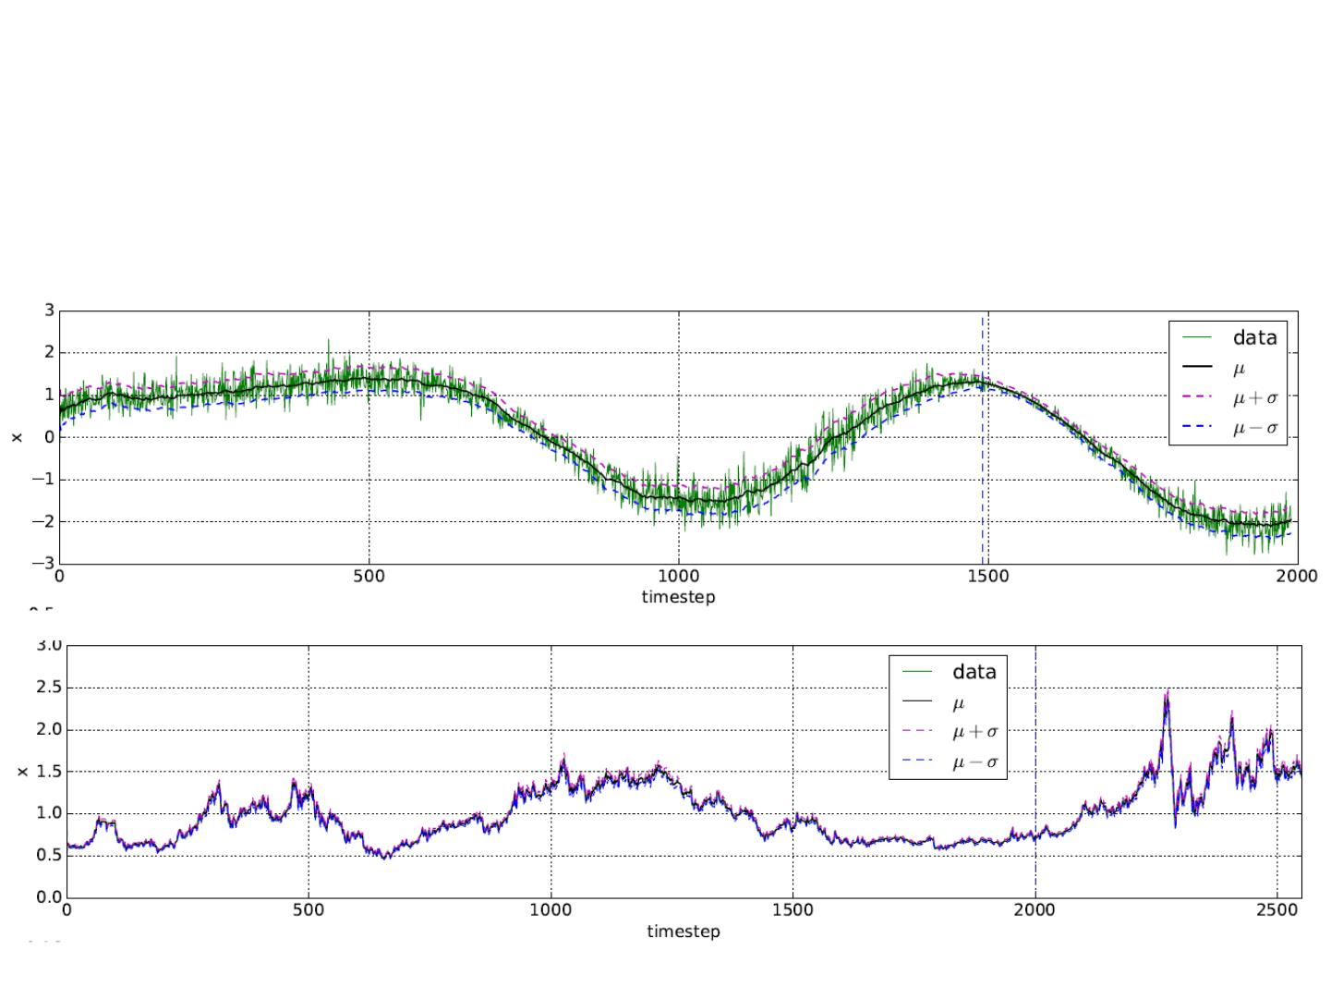
ML Use Case 6: Financial Data Prediction
• Predict the trend and volatility of financial data
Rui Luo, Xiaojun Xu, Weinan Zhang et al. A Neural Stochastic Volatility Model. AAAI 2018.

Slide 45
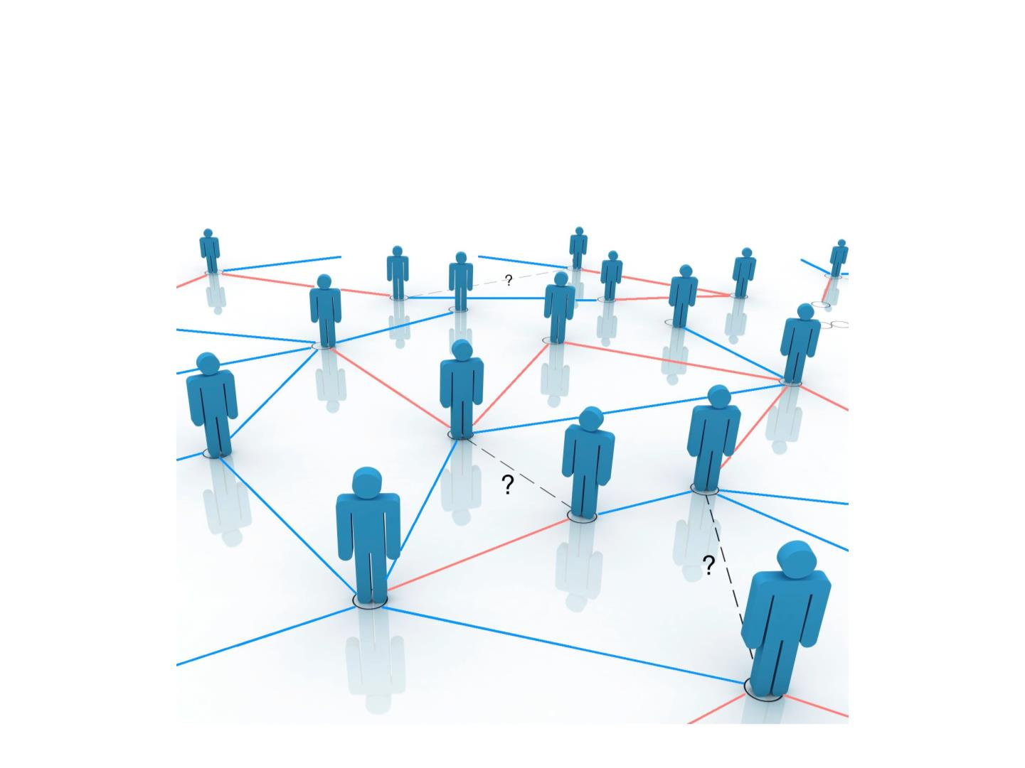
ML Use Case 7: Social Networks
• Friends/Tweets/Job Candidates suggestion

Slide 46

ML Use Case 8: Anomaly Detection
• Detect malicious calls
Huichen Li, Xiaojun Xu, Weinan Zhang et al. A Machine Learning Approach To Prevent Malicious Calls Over Telephony Networks. Oakland 2018.

Slide 47
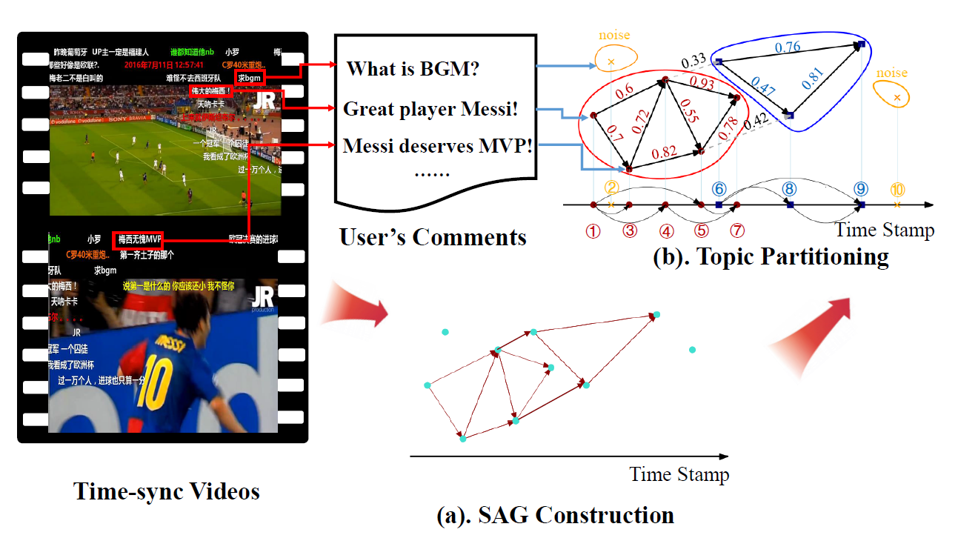
ML Use Case 9: Mining Tags in “Barrage--弹幕”
1. Graph Construction
2. Topic Partitioning & Radius
3. Weight Distribution and Tag Extraction
Outcomes:
{User A, “Messi”, User B}
{ Video V, “Messi”, [0:18, 0:24]}
W M Yang, Weijia Jia, Crowdsourced Time-sync Video Tagging using Semantic Association Graph, ICME, 2017

Slide 48
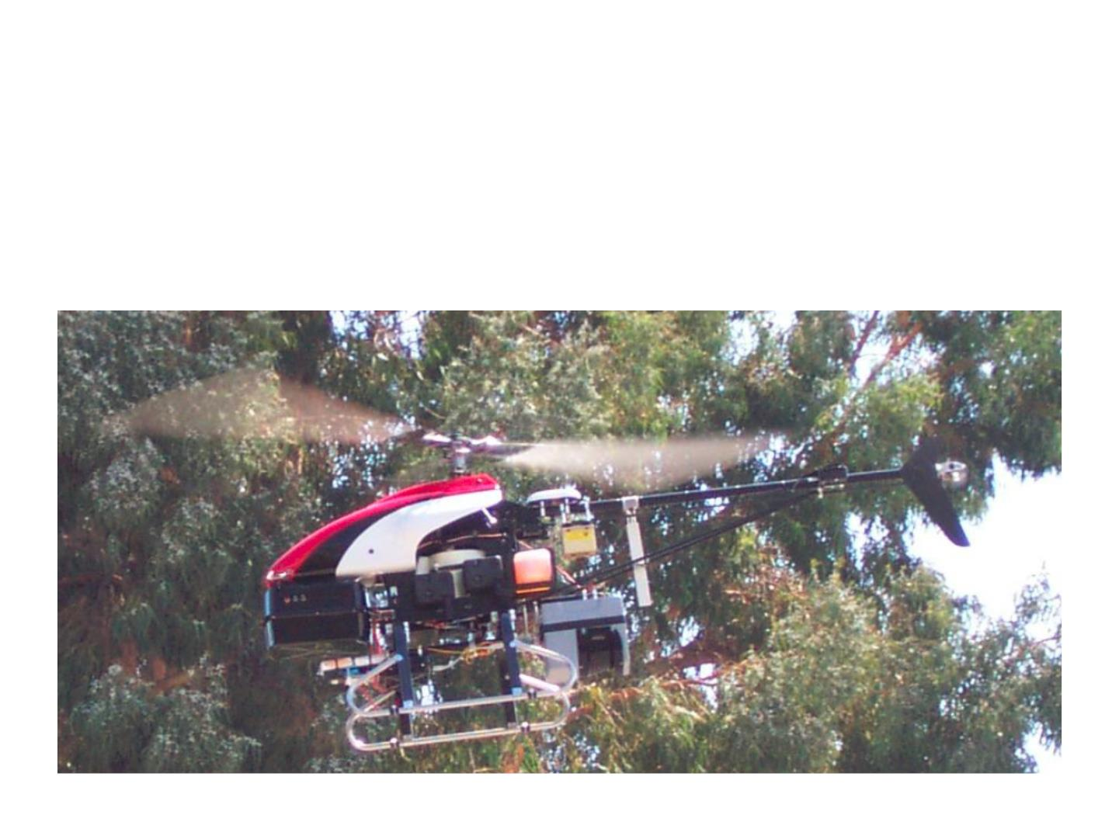
ML Use Case 10: Robotics Control
• Stanford Autonomous Helicopter
• http://heli.stanford.edu/

Slide 49
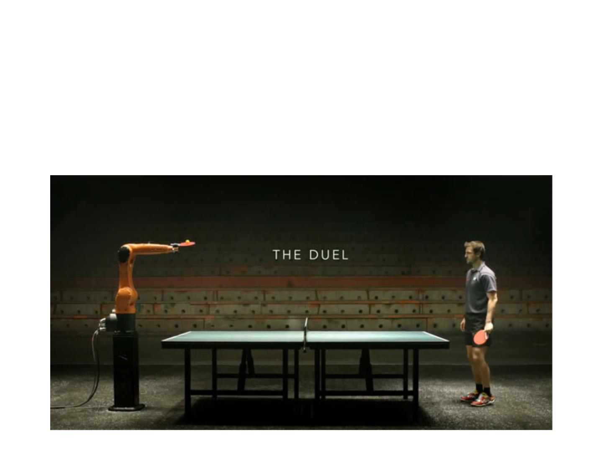
ML Use Case 10: Robotics Control
• Ping pong robot
• https://www.youtube.com/watch?v=tIIJME8-au8

Slide 50
ML Use Case 11: Multi-labeled Relation Extraction
ID | Relations
S1 | per/pla_l and per/pla_d
... | ...
ID | Instances | Relations
S1 | [Arthur Lee], the leader of Love, died on Thursday in [Memphis]. | person/place_death person/place_lived
S2 | [Arthur Lee] was born in [Memphis], Tennessee, and lived there until 1952. | person/place_birth person/place_lived
S3 | [Abraham Lincoln] was an American statesman and lawyer who served as the 16th President of the [United States]. | person/president_of person/nationality
Overlapping
Relations
Relation Predicting
Soft-Margin Loss
Discrete
Features
Feature Clustering
Attentive Capsule Network
Feature Extracting
Bi-LSTM Network
Problems
Challenges
Our Solution
XS Zhang, P. Li, Weijia Jia, H.Zhao, Multi-labeled Relation Extraction with Attentive Capsule Network– AAAI 19

Slide 51
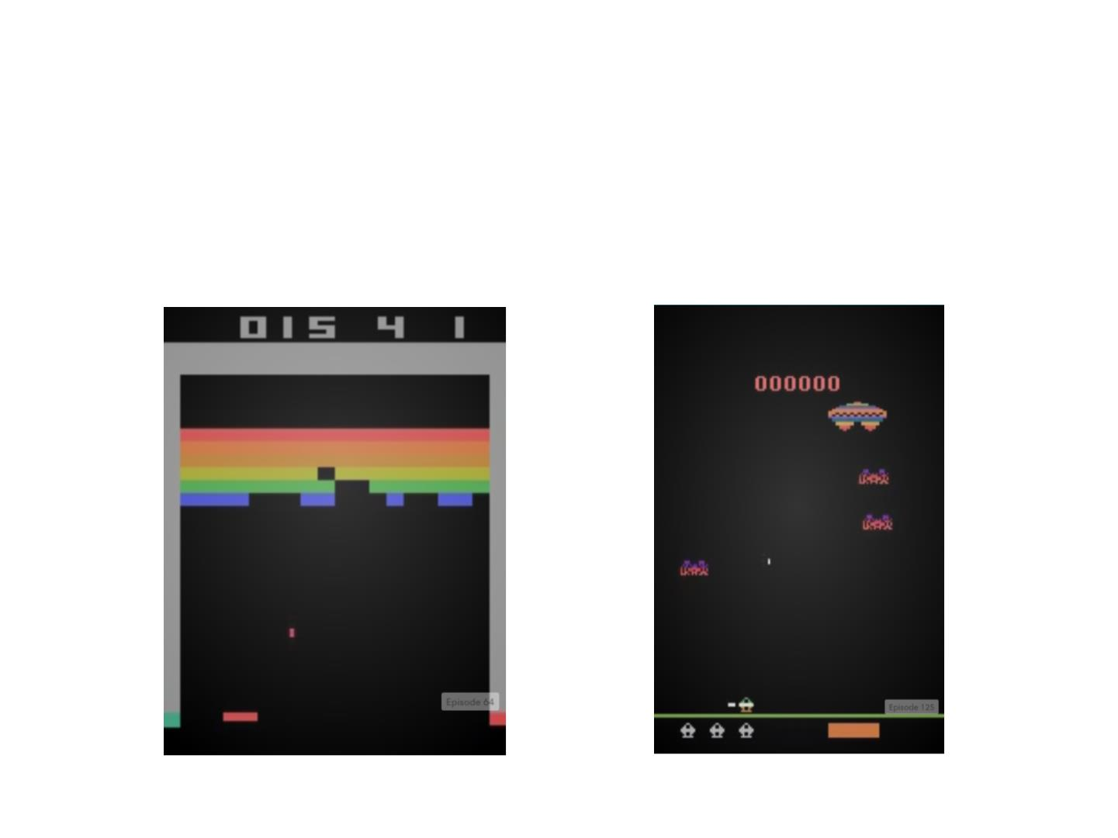
ML Use Case 12: Game Playing
• Ta ke actions given screen pixels
• https://gym.openai.com/envs#atari
Mnih, Volodymyr, et al. "Human-level control through deep reinforcement learning." Nature 518.7540 (2015): 529-533.

Slide 52
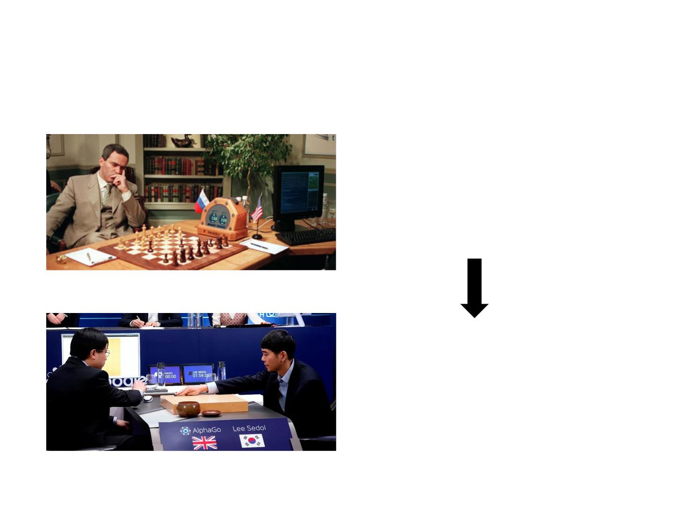
ML Use Case 13: AlphaGo
IBM Deep Blue (1996)
• 4-2 Garry Kasparov on Chess
• A large number of crafted rules
• Huge space search
Google AlphaGo (2016)
• 4-1 Lee Sedol on Go
• Deep machine learning on big data
Silver, David, et al. "Mastering the game of Go with deep neural networks and tree search."
Nature 529.7587 (2016): 484-489.

Slide 53
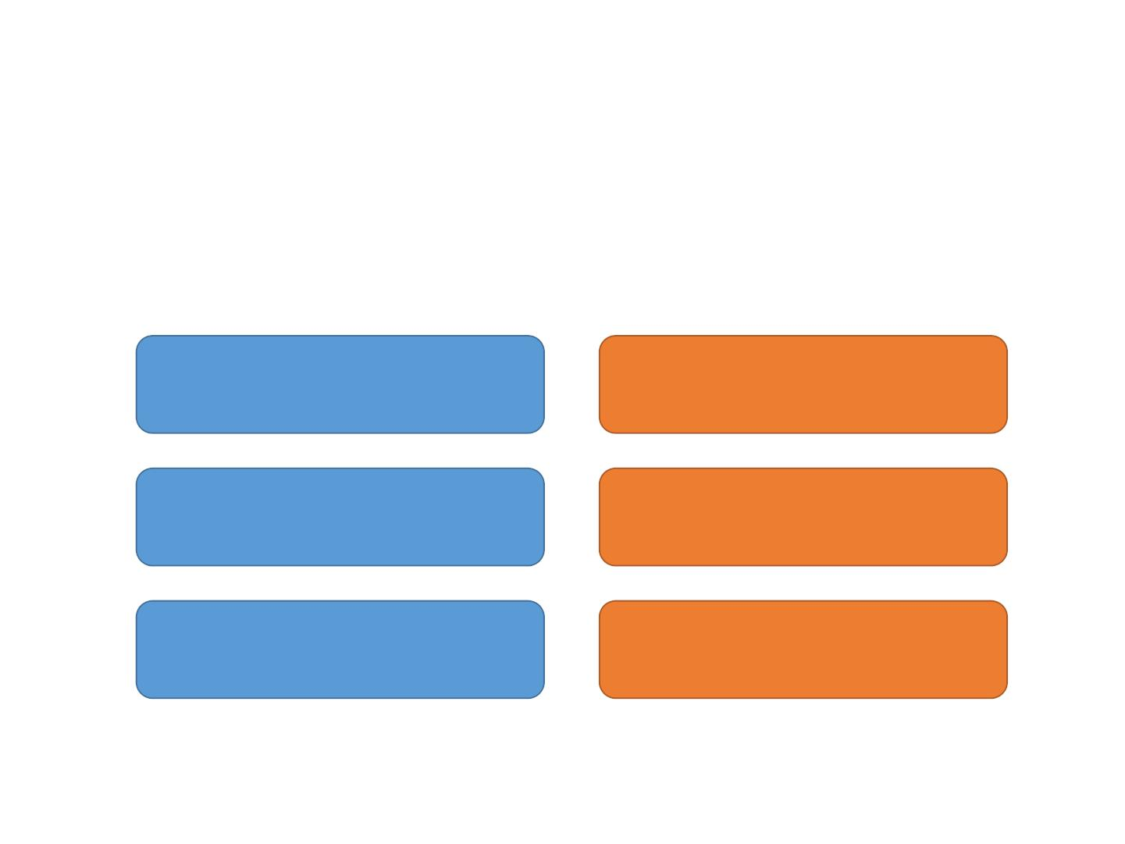
ML Use Case 14: Text Generation
• Making decision of selecting the next word/char
• Chinese poem example. Can you distinguish?
南陌春风早，东邻去日斜。
紫陌追随日，青门相见时。
山夜有雪寒，桂里逢客时。
此时人且饮，酒愁一节梦。
胡风不开花，四气多作雪。
四面客归路，桂花开青竹。
Human
Machine
Jiaxian Guo, Sidi Lu, Weinan Zhang et al. Long Text Generation via Adversarial Training with Leaked Information. AAAI 2018.
Lantao Yu, Weinan Zhang, et al. Seqgan: sequence generative adversarial nets with policy gradient. AAAI 2017.
Notes:
杂曲歌辞·浣沙女
作者：佚名
南陌春风早，东邻去日斜。 千花开瑞锦，香扑美人车。 长乐青门外，宜春小苑东。 楼开万户上，人向百花中。
送崔主簿赴沧州
作者：李峤
紫陌追随日，青门相见时。 宦游从此去，离别几年期。 芳桂尊中酒，幽兰下调词。 他乡有明月，千里照相思。
横吹曲辞·出塞
作者：刘驾
胡风不开花，四气多作雪。 北人尚冻死，况我本南越。 古来犬羊地，巡狩无遗辙。 九土耕不尽，武皇犹征伐。 中天有高阁，图画何时歇。 坐恐塞上山，低于砂中骨。
https://www.wjx.cn/jq/9518681.aspx

Slide 54
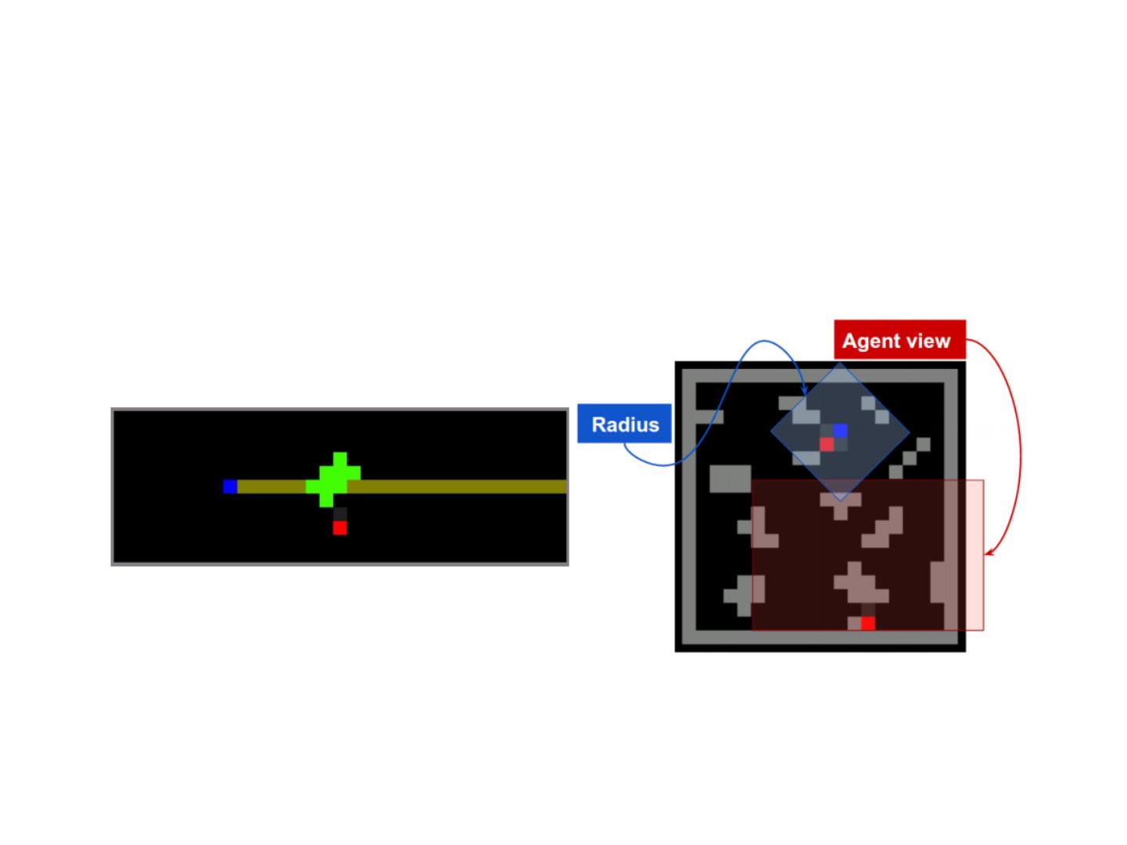
ML Use Case 15: Multi-Agent Game Playing
• Multi-agent game playing
• Learning to cooperate and compete
Leibo, Joel Z., et al. "Multi-agent Reinforcement Learning in Sequential Social Dilemmas." AAMAS 2017.

Slide 55
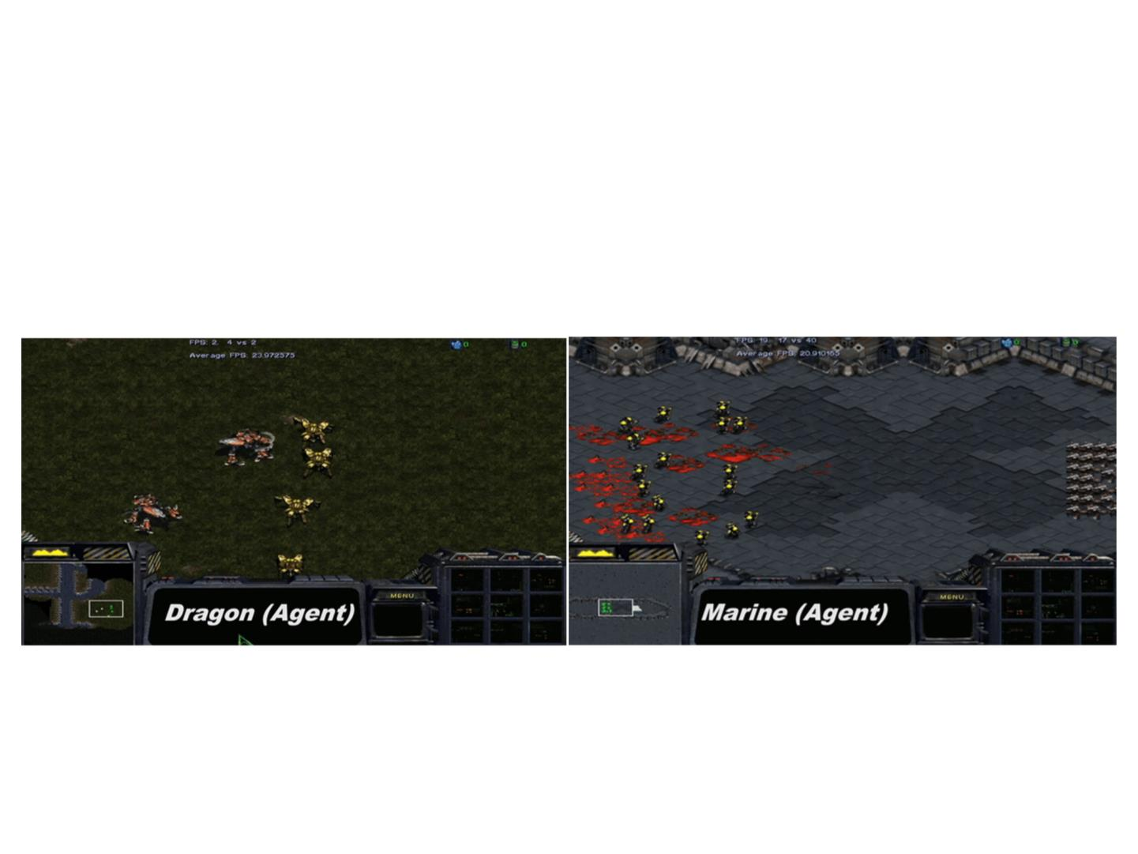
ML Use Case 15: Multi-Agent Game Playing
• Multi-agent game playing
• Learning to cooperate and compete
Peng Peng, Jun Wang et al. Multiagent Bidirectionally-Coordinated Nets: Emergence of Human-level Coordination in Learning to
Play StarCraft Combat Games. NIPS workshop 2017.

Slide 56
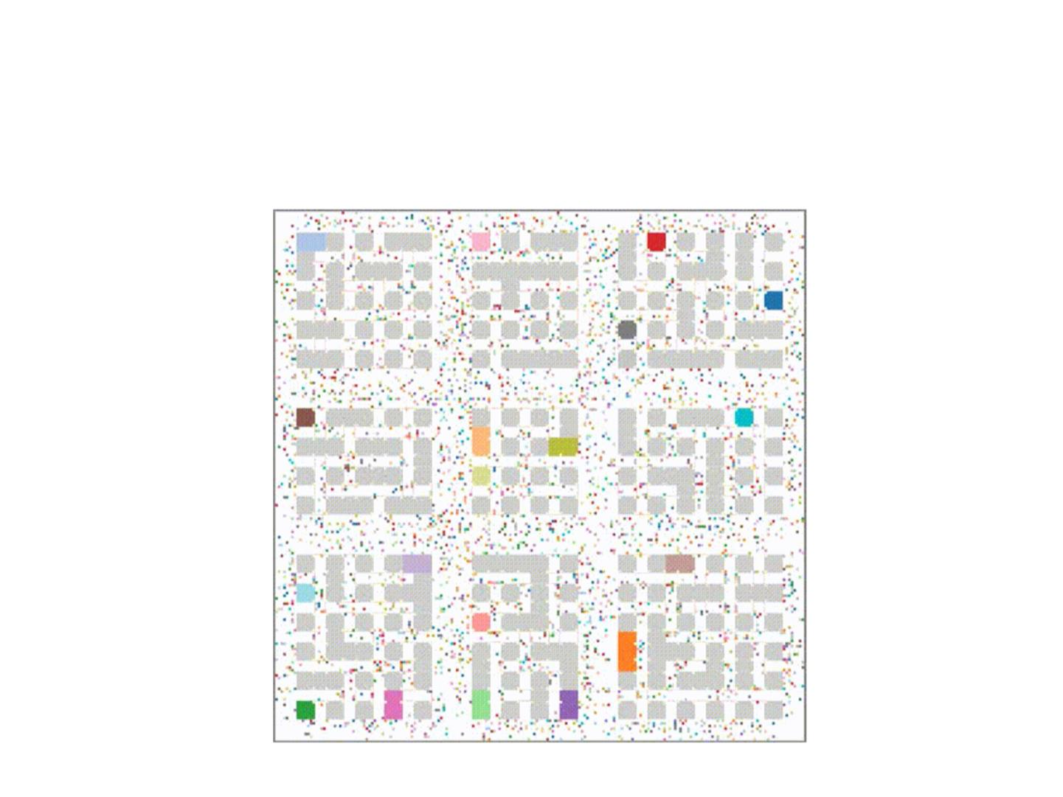
ML Use Case 16: Many-Agent Interactions
• MAgent game: city simulation
Lianmin Zheng, Jiacheng Yang et al. MAgent: A Many-Agent Reinforcement Learning Platform for Artificial Collective Intelligence. NIPS 2017 & AAAI 2018 Demos.

Slide 57
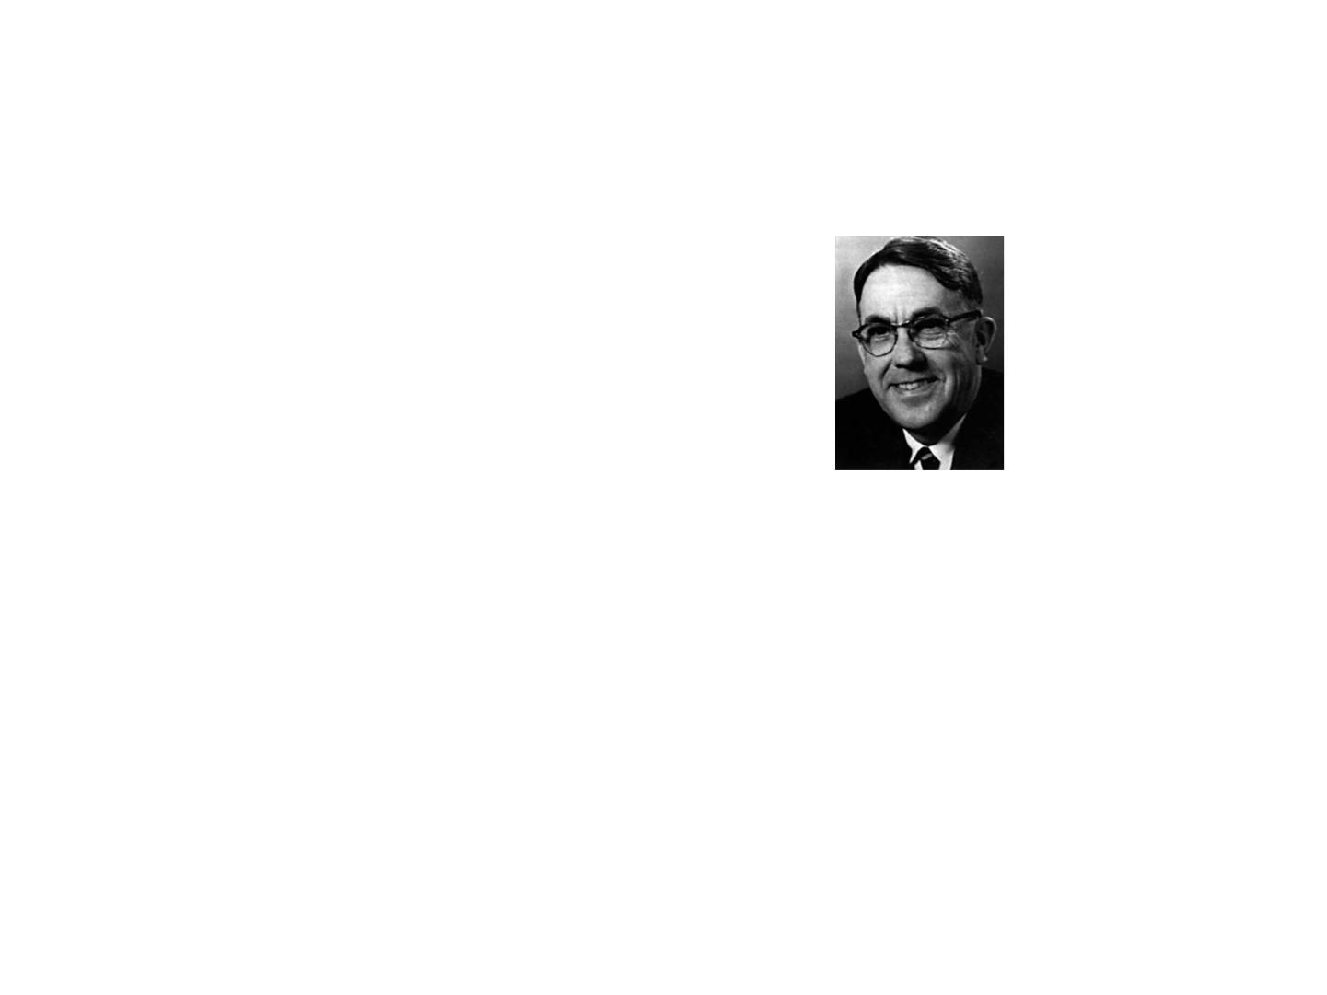
History of Machine Learning
• 1950s
• Samuel’s checker player
• Machine learning term created
• 1960s:
Arthur Samuel
coined the term
“machine learning”
in 1959
• Neural networks: Perceptron
• Pattern recognition
• Minsky and Papert prove limitations of Perceptron
• 1970s:
• Symbolic concept induction
• Winston’s arch learner
• Expert systems and the knowledge acquisition bottleneck
• Quinlan’s ID3
• Mathematical discovery with AM
Slide credit: Ray Mooney

Slide 58
History of Machine Learning
• 1980s:
• Advanced decision tree and rule learning
• Explanation-based Learning (EBL)
• Learning and planning and problem solving
• Utility problem
• Analogy
• Cognitive architectures
• Resurgence of neural networks (connectionism, backpropagation)
• Valiant’s PAC Learning Theory
• Focus on experimental methodology
• 1990s
• Data mining
• Adaptive software agents and web applications
• Text learning
• Reinforcement learning (RL)
• Inductive Logic Programming (ILP)
• Ensembles: Bagging, Boosting, and Stacking
• Bayes Net learning
• Support vector machines
• Kernel methods
Slide credit: Ray Mooney

Slide 59
History of Machine Learning
• 2000s
• Graphical models
• Variational inference
• Statistical relational learning
• Transfer learning
• Sequence labeling
• Collective classification and structured outputs
• Computer systems applications
• Compilers
• Debugging
• Graphics
• Security (intrusion, virus, and worm detection)
• Email management
• Personalized assistants that learn
• Learning in robotics and vision
Slide credit: Ray Mooney

Slide 60
History of Machine Learning
• 2010s
• Deep learning
• Learning from big data
• Learning with GPUs or HPC
• Multi-task & lifelong learning
• Deep reinforcement learning
• Massive applications to vision, speech, text, networks,
behavior etc.
• …
Slide credit: Ray Mooney

Slide 61
Machine Learning Categories
• Supervised Learning
• To perform the desired output given the data and labels
• Unsupervised Learning
• To analyze and make use of the underlying data
patterns/structures
• Reinforcement Learning
• To learn a policy of taking actions in a dynamic
environment and acquire rewards

Slide 62
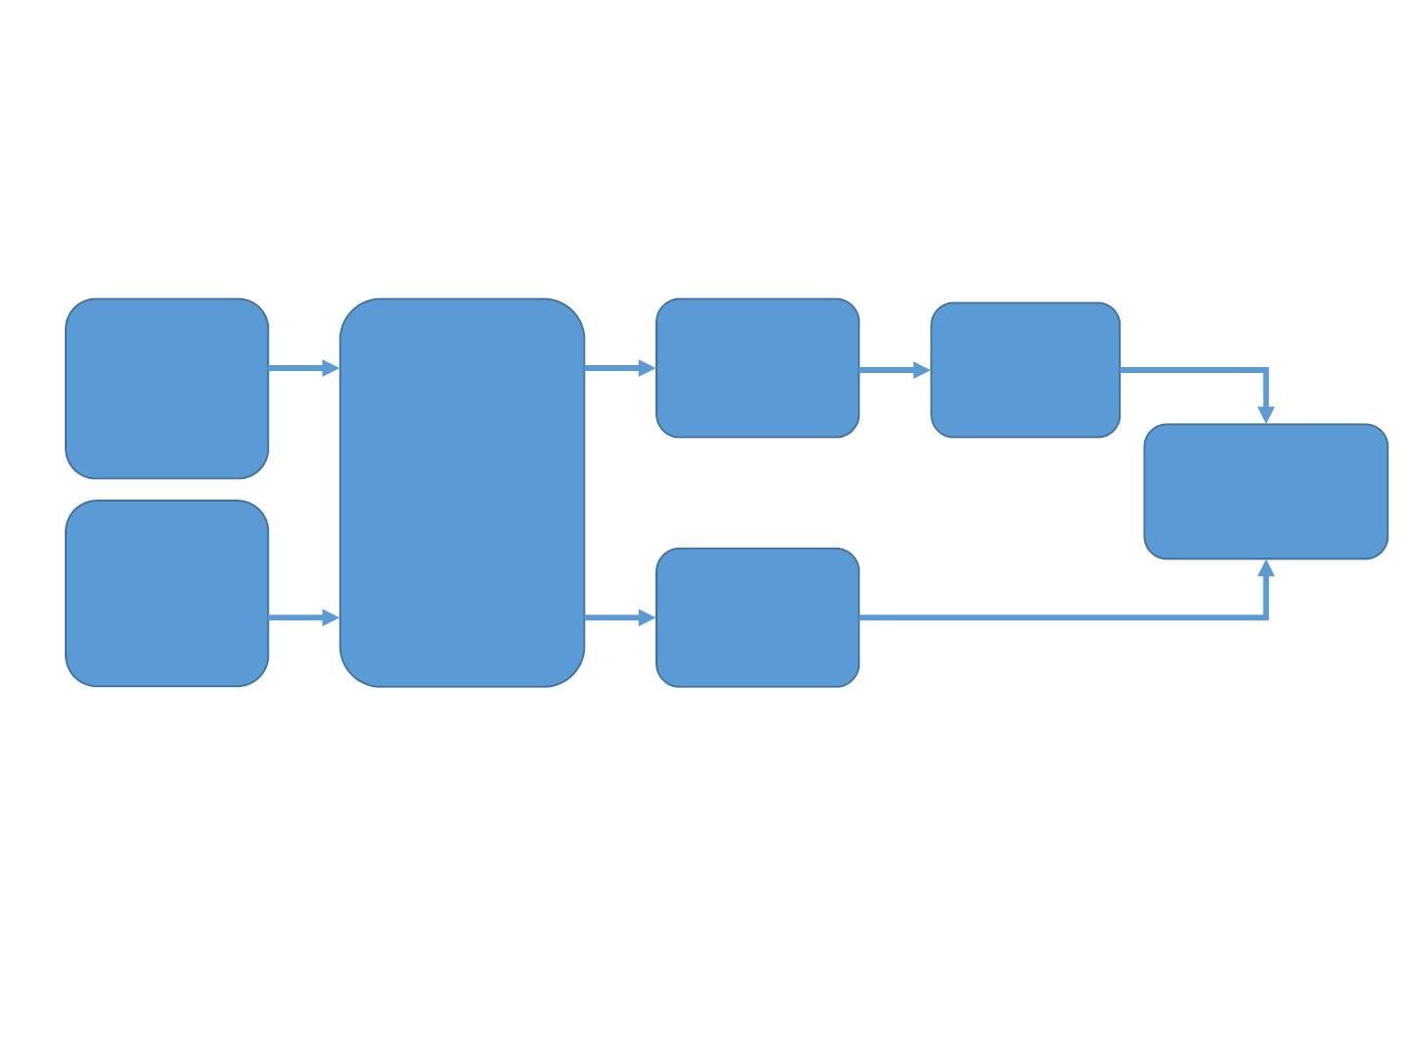
ML Process
Raw
Data
Training
Model
Data
Data
Formaliz-
ation
Evaluation
Raw
Data
Test
Data
• Basic assumption: there exist the same patterns
across training and test data

Slide 63
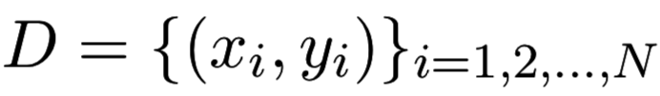
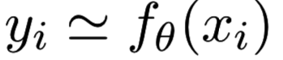
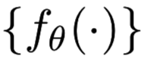
Supervised Learning
• Given the training dataset of (data, label) pairs,
let the machine learn a function from data to label
• Function set
is called hypothesis space
• Learning is referred to as updating the parameter$θ$
• How to learn?
• Update the parameter to make the prediction close to
corresponding label
• What is the learning objective?
• How to update the parameters?

Slide 64
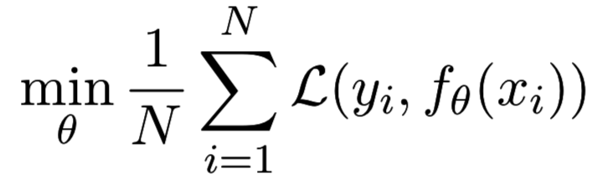
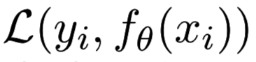
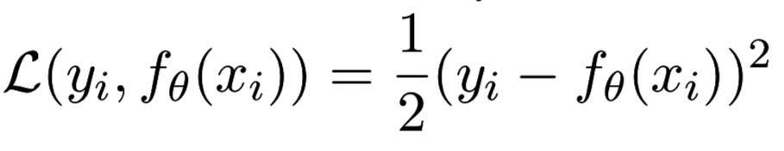
Learning Objective
• Make the prediction closed to the corresponding
• Loss function
measures the error
between the label and prediction
• The definition of loss function depends on the data
and task
• Most popular loss function: squared loss

Slide 65
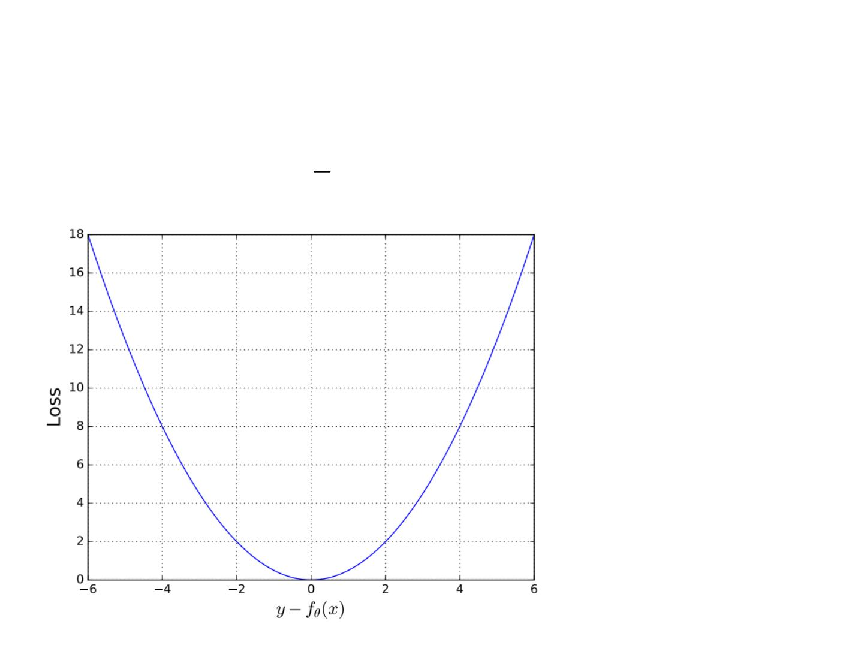
Squared Loss
• Penalty much
more on larger
distances
• Accept small
distance (error)
• Observation
noise etc.
• Generalization

Slide 66
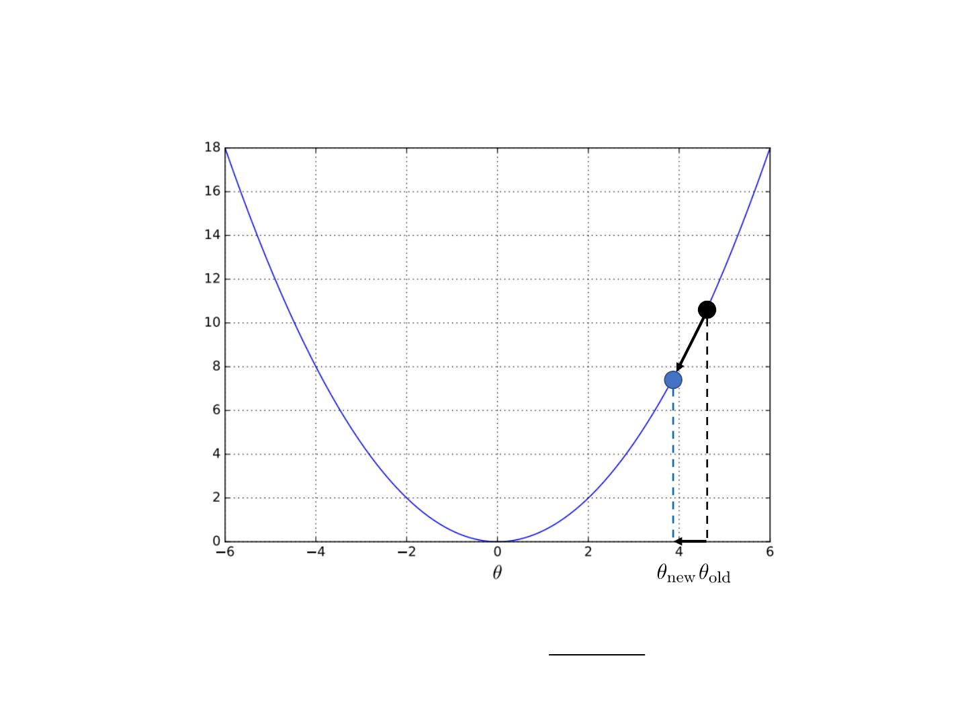
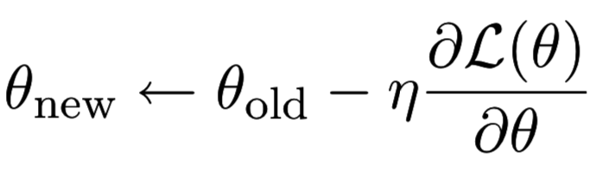
Gradient Learning Methods
L(⍬)

Slide 67
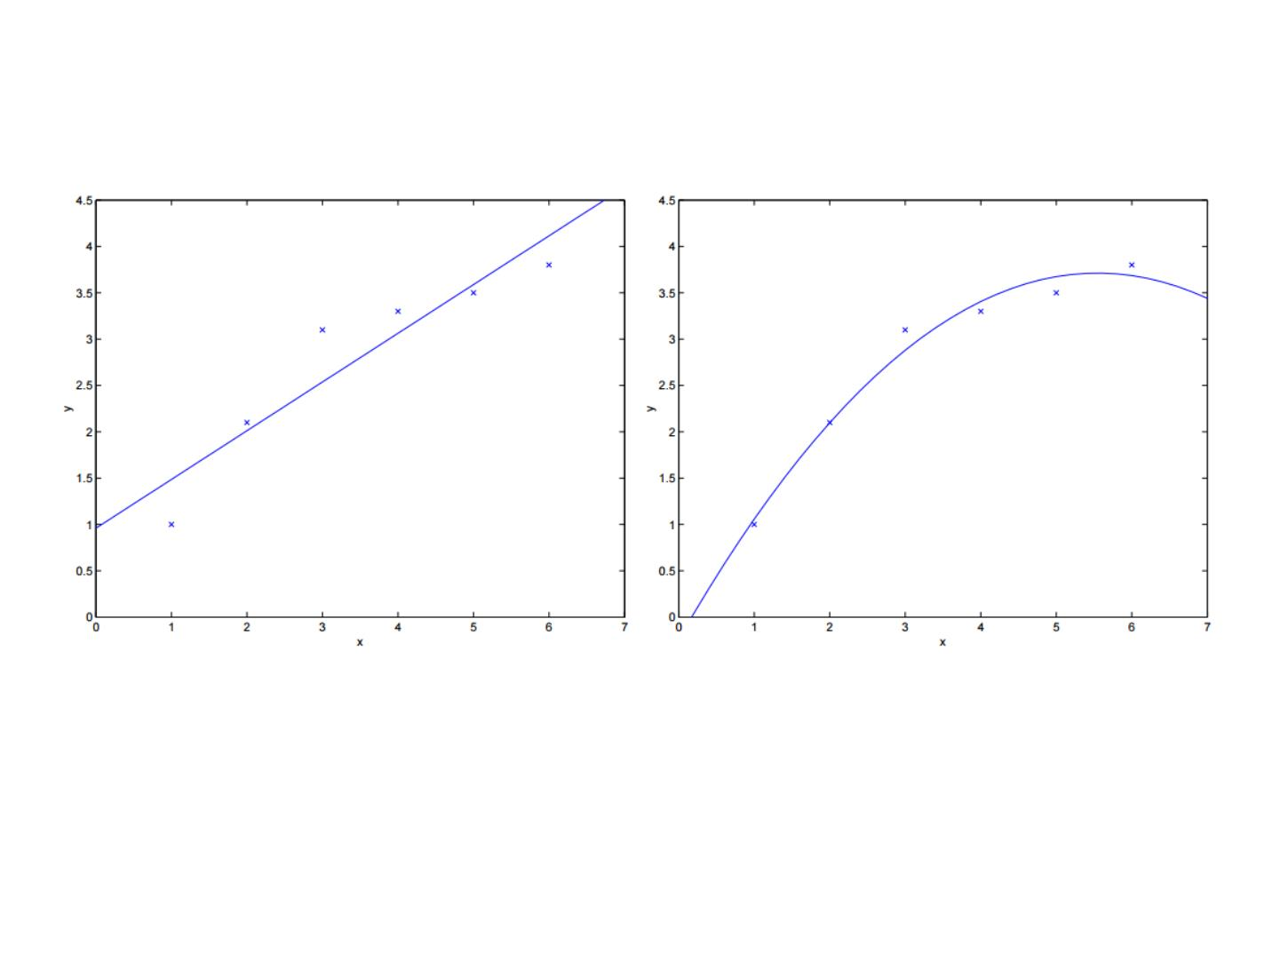
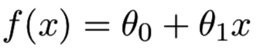
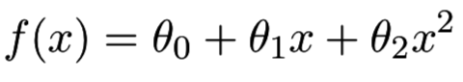
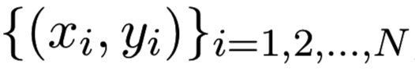
A Simple Example
• Observing the data
, we can use
different models (hypothesis spaces) to learn
• First, model selection (linear or quadratic)
• Then, learn the parameters
An example from Andrew Ng

Slide 68
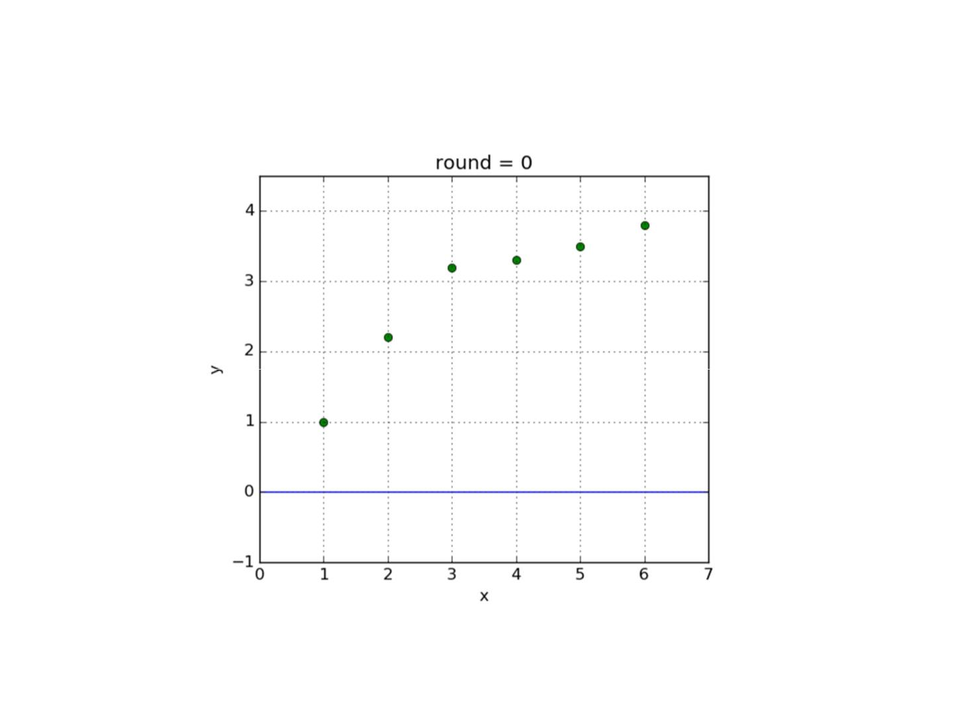
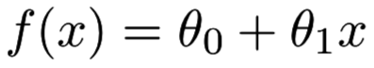
Learning Linear Model - Curve

Slide 69
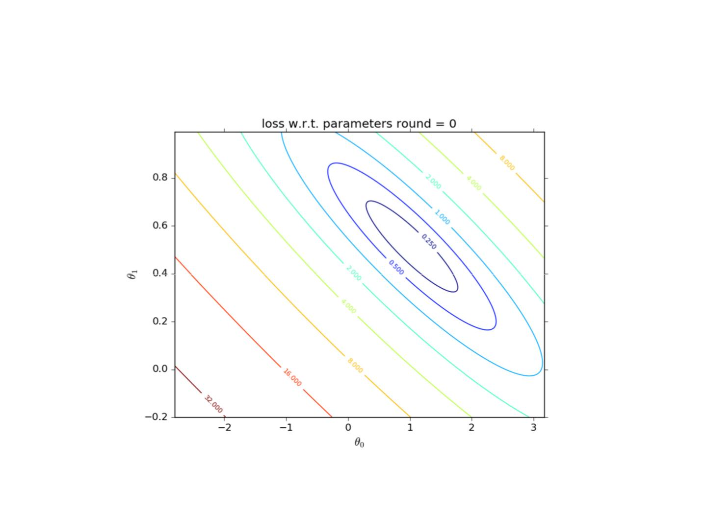
Learning Linear Model - Weights

Slide 70
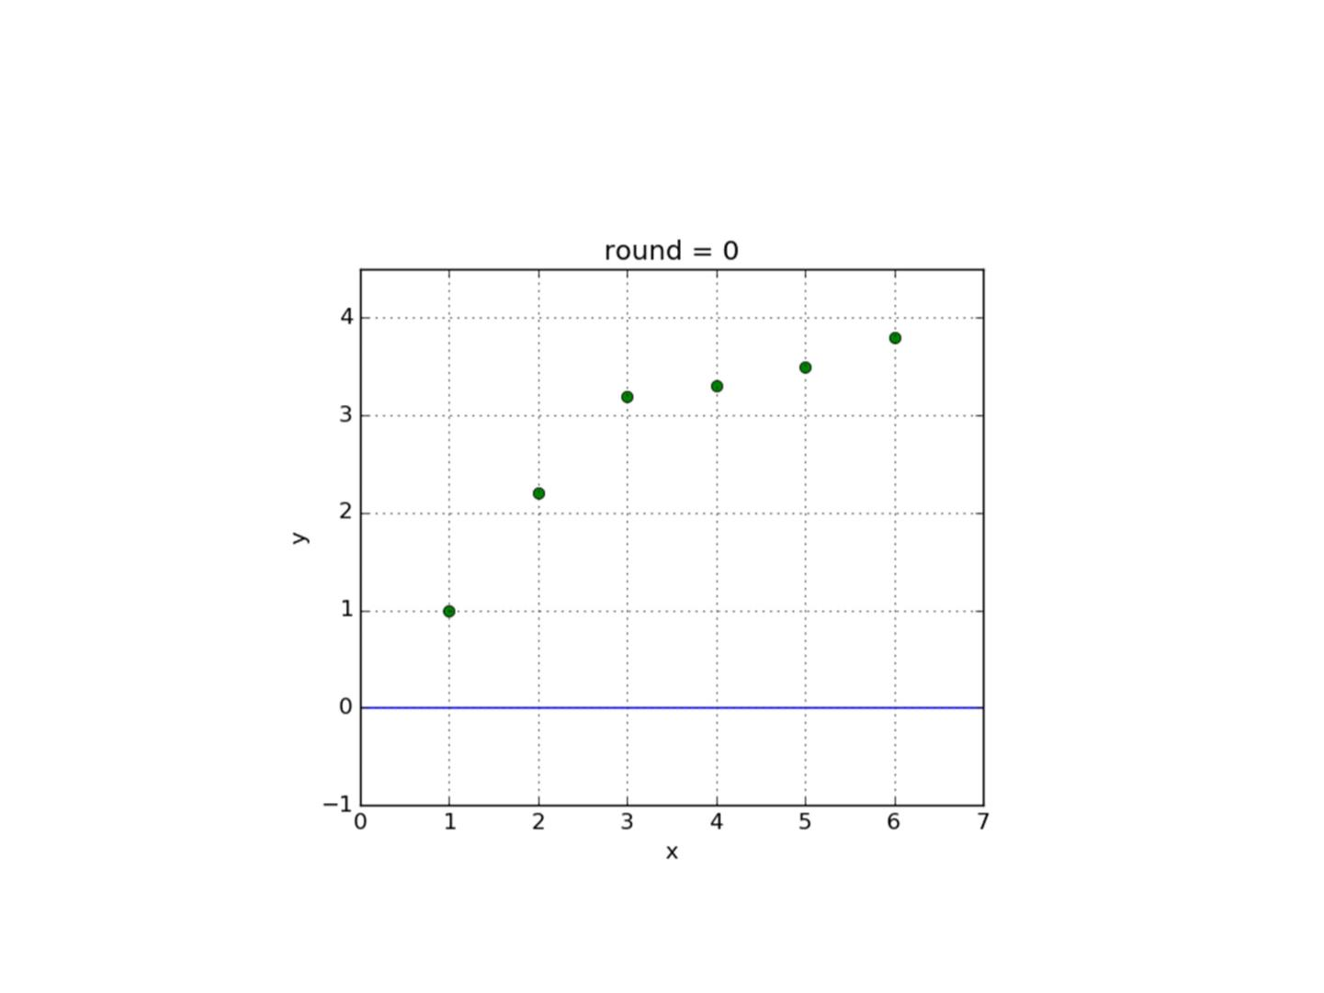

Learning Cubic Model

Slide 71

Model Selection
• Which model is the best?
Linear model: underfitting
Quadratic model: well fitting
5th-order model: overfitting
• Underfitting occurs when a statistical model or machine learning
algorithm cannot capture the underlying trend of the data.
• Overfitting occurs when a statistical model describes random error or
noise instead of the underlying relationship

Slide 72

Model Selection
• Which model is the best?
Linear model: underfitting
4th-order model: well fitting
15th-order model: overfitting
• Underfitting occurs when a statistical model or machine learning
algorithm cannot capture the underlying trend of the data.
• Overfitting occurs when a statistical model describes random error or
noise instead of the underlying relationship

Slide 73


Regularization
• Add a penalty term of the parameters to prevent
the model from overfitting the data

Slide 74





Typical Regularization
• L2-Norm (Ridge)
• L1-Norm (LASSO)

Slide 75


More Normal-Form Regularization
• Contours of constant value of
Ridge
LASSO
• Sparse model learning with q not higher than 1
• Seldom use of q > 2
• Actually, 99% cases use q = 1 or 2

Slide 76


Principle of Occam's razor
Among competing hypotheses, the one with
the fewest assumptions should be selected.
• Recall the function set
is called hypothesis
space
Original loss
Penalty on assumptions

Slide 77




Model Selection
• A ML solution has model parameters and
$$θ$$
optimization hyperparameter $λ$
• Hyperparameters
• Define higher level concepts about the model such as
complexity, or capacity to learn.
• Cannot be learned directly from the data in the standard
model training process and need to be predefined.
• Can be decided by setting different values, training different
models, and choosing the values that test better
• Model selection (or hyperparameter optimization)
cares how to select the optimal hyperparameters.

Slide 78

Cross Validation for Model Selection
Training
Model
Data
Original
Random
Training
Data
Evaluation
Split
Validation
Data
K-fold Cross Validation
1. Set hyperparameters
2. For K times repeat:
• Randomly split the original training data into training and validation
datasets
• Train the model on training data and evaluate it on validation data,
leading to an evaluation score
3. Average the K evaluation scores as the model performance

Slide 79
ML Process
Raw
Data
Training
Model
Data
Data
Formaliz-
ation
Evaluation
Raw
Data
Test
Data
• After selecting ‘good’ hyperparameters, we train
the model over the whole training data and the
model can be used on test data.

Slide 80


Generalization Ability
• Generalization Ability is the model prediction
capacity on unobserved data
• Can be evaluated by Generalization Error, defined by
• where
p(x, y)
is the underlying (probably unknown)
joint data distribution
• Empirical estimation of GA on a training dataset is

Slide 81



Discriminative Model and Generative Model
• Discriminative model
• modeling the dependence of unobserved variables on
observed ones
• also called conditional models.
• Deterministic:
• Probabilistic:
• Generative model
• modeling the joint probabilistic distribution of data
• given some hidden parameters or variables
p (x, y)
$$θ$$
• then do the conditional inference
=

Slide 82
Discriminative Model and Generative Model
• Discriminative model
• modeling the dependence of unobserved variables on
observed ones
• also called conditional models.
• Deterministic:
• Probabilistic:
• Directly model the dependence for label prediction
• Easy to define dependence-specific features and models
• Practically yielding higher prediction performance
• Linear regression, logistic regression, k nearest neighbor, SVMs,
(multi-layer) perceptrons, decision trees, random forest etc.

Slide 83


Discriminative Model and Generative Model
• Generative model
• modeling the joint probabilistic distribution of data
• given some hidden parameters or variables
p (x, y)
$$θ$$
• then do the conditional inference
• Recover the data distribution [essence of data science]
• Benefit from hidden variables modeling
• Naive Bayes, Hidden Markov Model, Mixture Gaussian, Markov
Random Fields, Latent Dirichlet Allocation etc.

Slide 84
Basic Categories of Machine Learning
Summary
Machine learning is generally divided into the following categories:
Supervised Learning
Unsupervised Learning
Reinforcement Learning
Representation Learning
Semi-supervised Learning
Deep Learning

Slide 85
Python Scikit-learn
Machine Learning in Python:
Scikit-learn (sklearn): http://scikit-learn.org/stable/
A simple and effective set of tools
Depends on Python's NumPy, SciPy and matplotlib libraries
Open source, reusable

Slide 86
Common Function in Scikit-learn
 | Applications | Algorithm
Classification | Anomaly detection, image recognition, etc. | KNN, SVM, etc.
Clustering | Image segmentation, group segmentation, etc. | K-Means, etc.
Regression | Price forecast, trend forecast, etc. | Linear regression, SVR，etc.
Dimension Reduction | Visualization | PCA，NMF，etc.

Slide 87
Course Landscape
1. ML Introduction
2. Linear Models
9. Unsupervised Learning
10. Model Selection
11. RL Introduction [-]
12. Model-free RL [-]
3. SVMs and Kernels [-optional]
4. Neural Networks
5. Tree Models
13. Multi-agent RL [-]
6. Ensemble Models [cw1]
14. Transfer Learning [-]
7. Ranking and Filtering [-] 15. Advanced ML
8. Graphic Models [-] 16. Presentation Session
Partial Slides Credits to Dr. Zhang Weinan, Shanghai Jiaotong Univ.

